Slide 1
Modern statistics in medical and genetic research
Supervisors: Nemes András Botond, Dr. Németh László, Dr. Firneisz Gábor
Somogyi Dalma
2026. 06. 04.

Slide 2
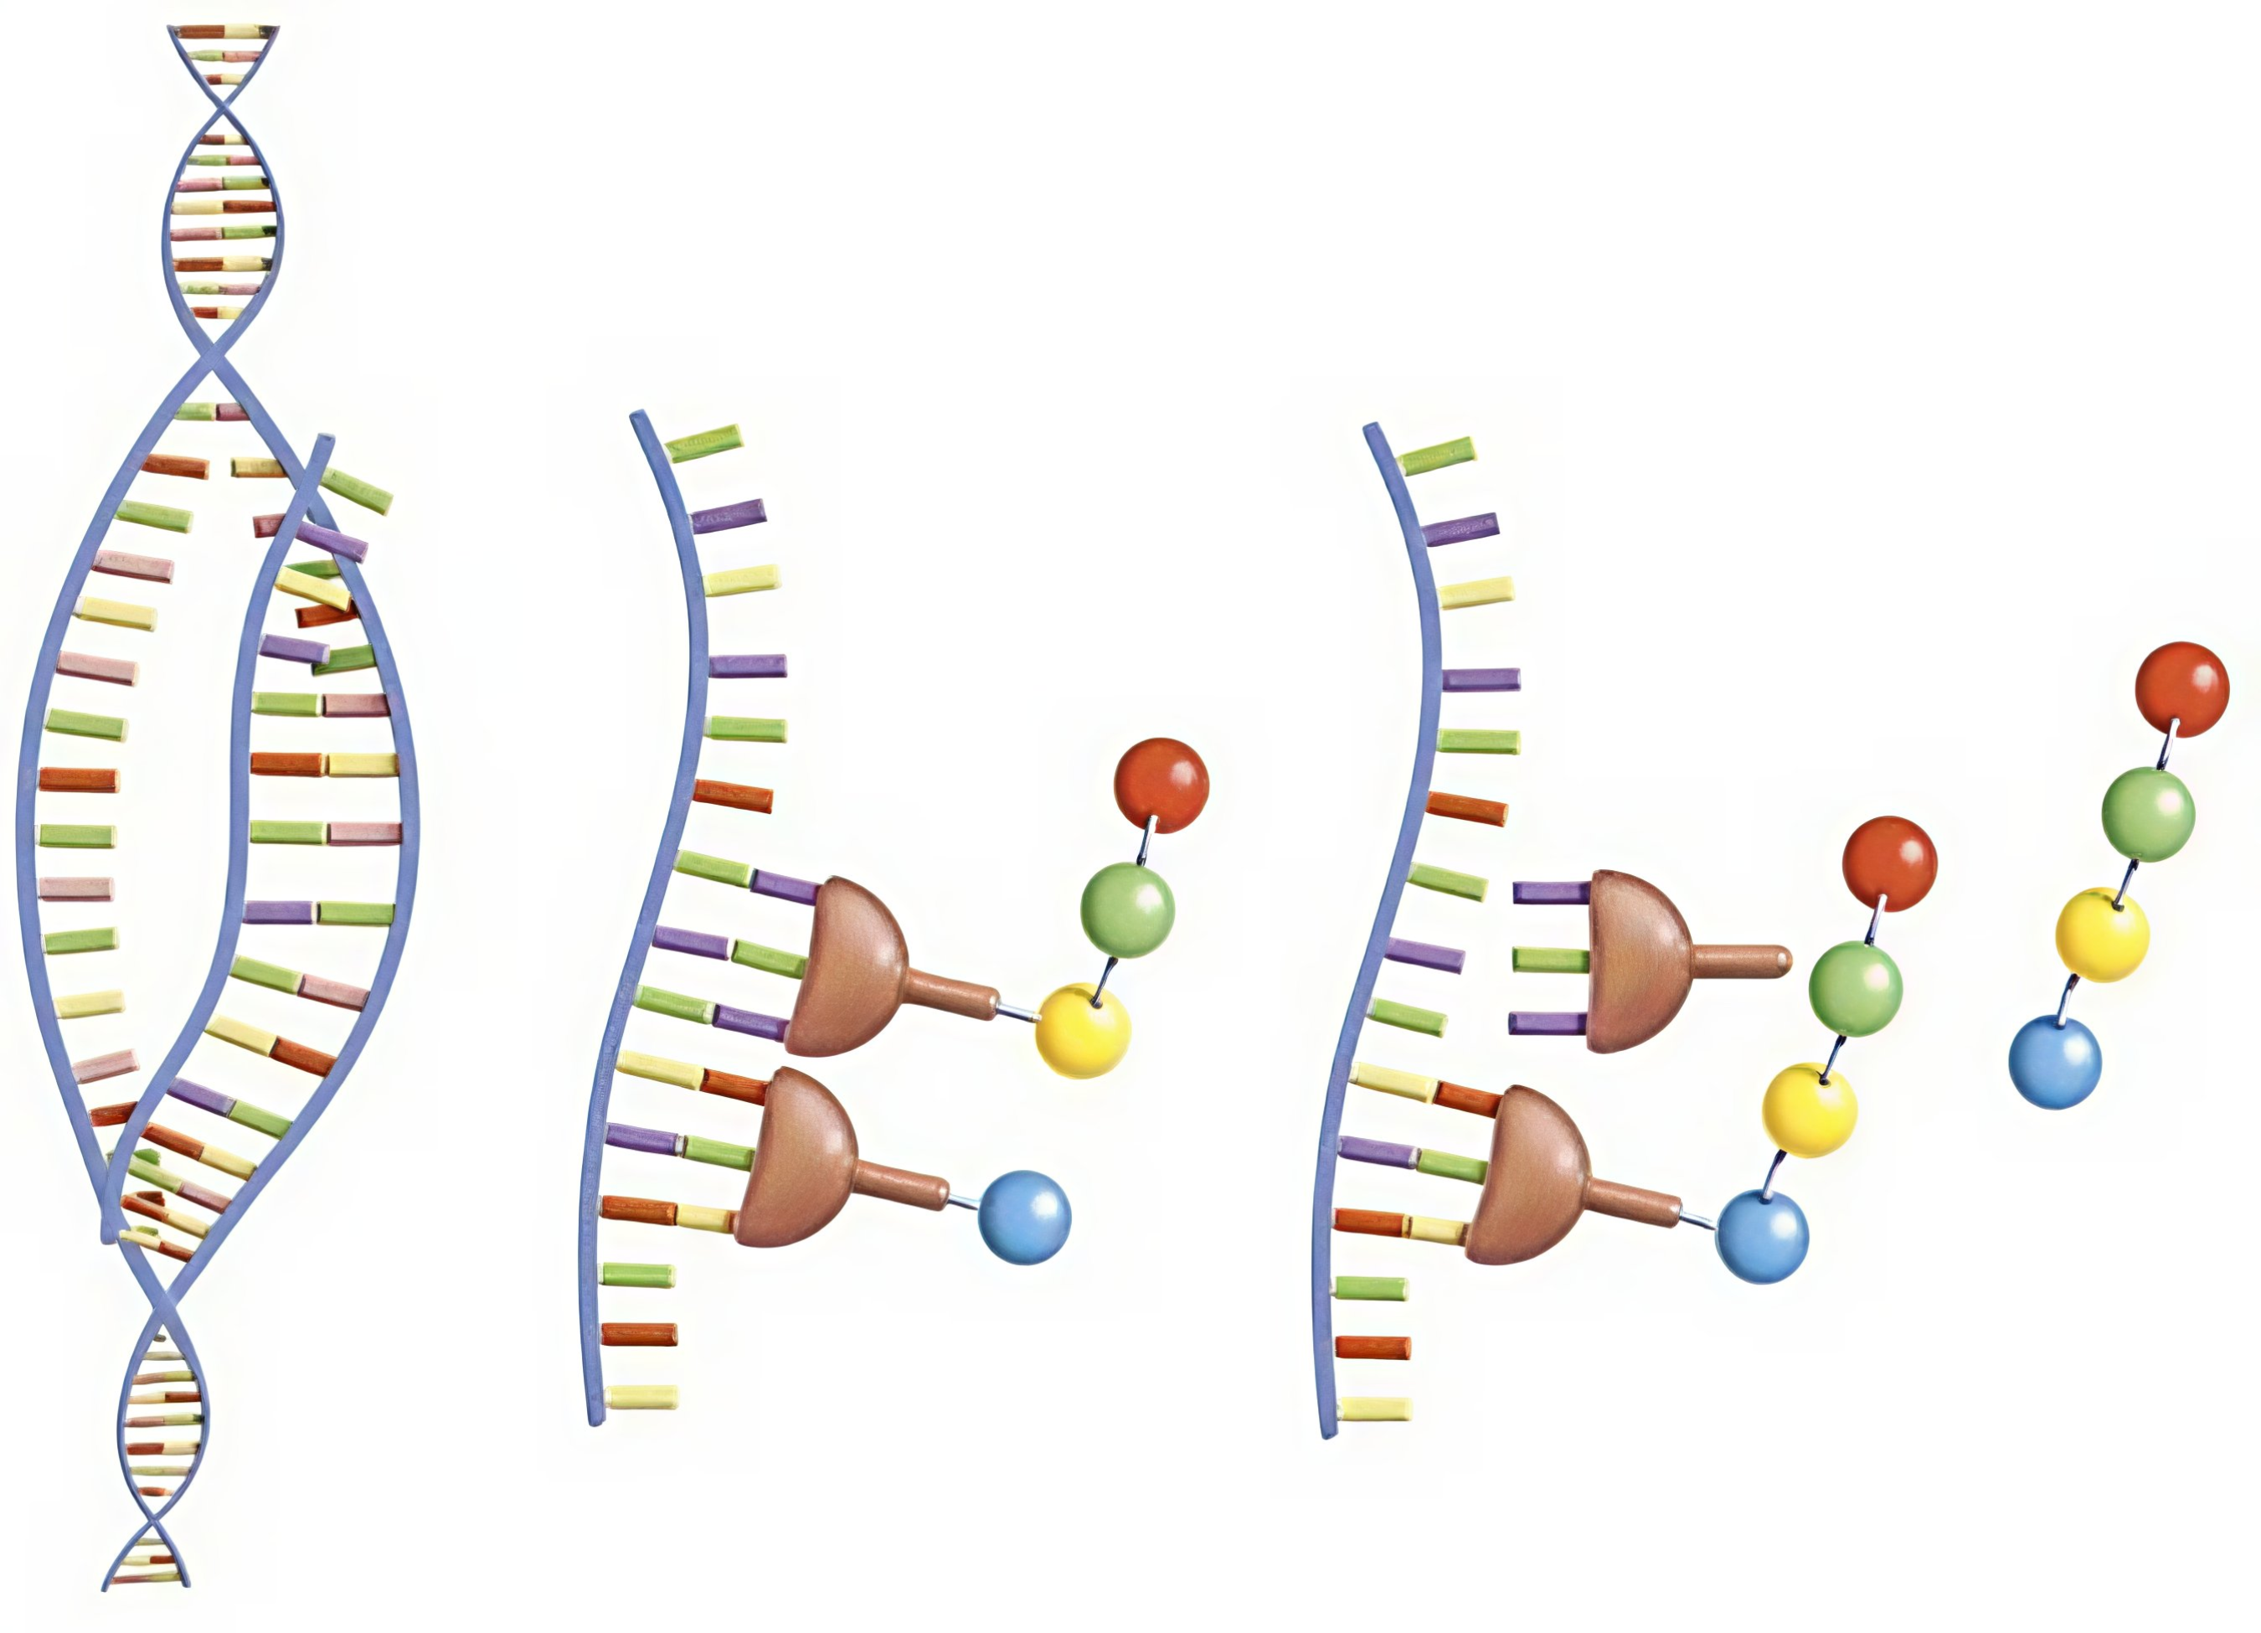
Background
https://www.sciencesource.com/1241399-protein-synthesis-stock-image-rights-managed.html

Slide 3
Goal
Epistasis detecting with interaction analysis
Eventually we want to use it on database on Gestational Diabetes Mellitus

Slide 4
Methods
1
3
5
2
4
Database on 4000 individuals' 3000 SNPs with 15 significant interactions
Grouping SNPs into LD-blocks
Representative vectors for each block
Block-level interactions with representatives
SNP-level interactions

Slide 5

Methods
Dataset: $X∈{\left\{0, 1, 2\right\}}^{4000×3000}$
Target: $Y∈{\left\{0, 1\right\}}^{3000}$

Slide 6
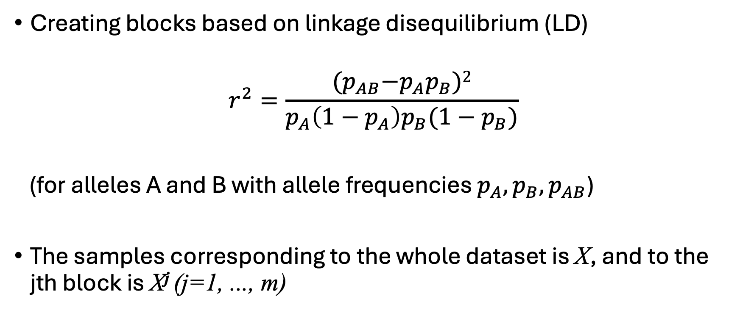
LD-based blocks
Creating blocks based on linkage disequilibrium (LD)
$$r^{2}=\frac{{(p}_{AB}−p_{A}p_{B})2}{p_{A}\left(1−p_{A}\right)p_{B}(1−p_{B})}$$
(for alleles A and B with allele frequencies $p_{A}, p_{B}, p_{AB}$)
The samples corresponding to the whole dataset is X, and to the jth block is X^{j} (j=1, ..., m)

Slide 7
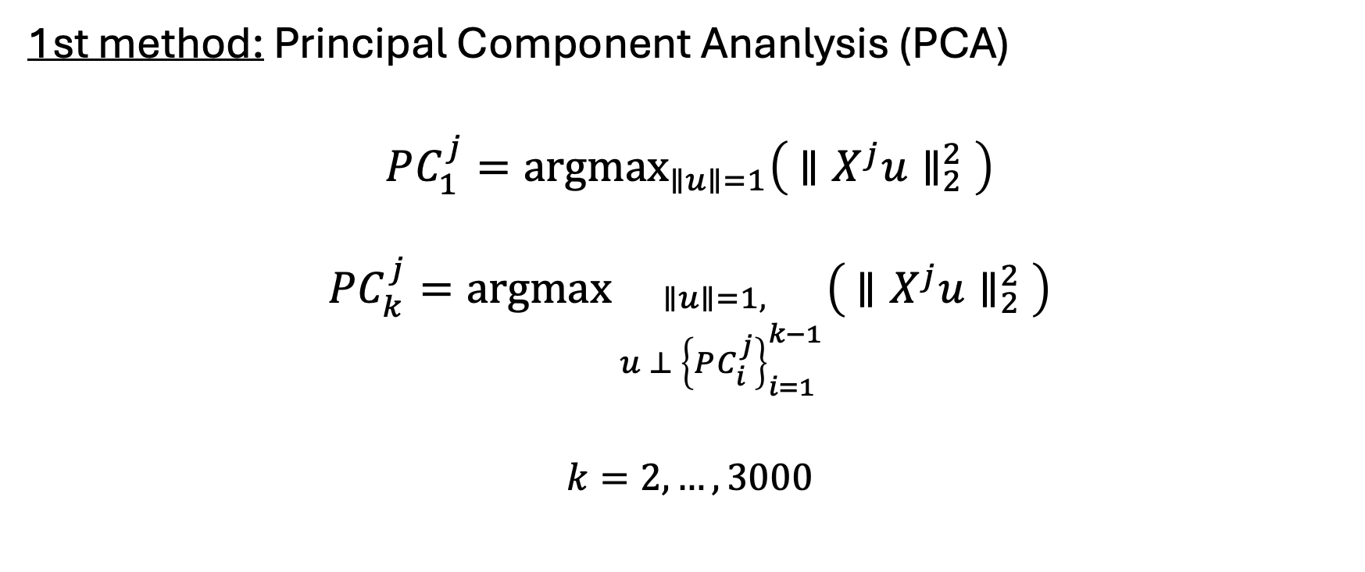
Block representatives
1st method: Principal Component Ananlysis (PCA)
$$PC_{1}^{j}={argmax}_{∥u∥=1}\left({ ∥X^{j}u∥}_{2}^{2} \right)$$
$$PC_{k}^{j}=argmax_{\begin{aligned}∥u∥=1, \\ u ⊥ {\left\{PC_{i}^{j}\right\}}_{i=1}^{k−1}\end{aligned}}\left( {∥X^{j}u∥}_{2}^{2} \right)$$
$$k=2, …, 3000$$

Slide 8
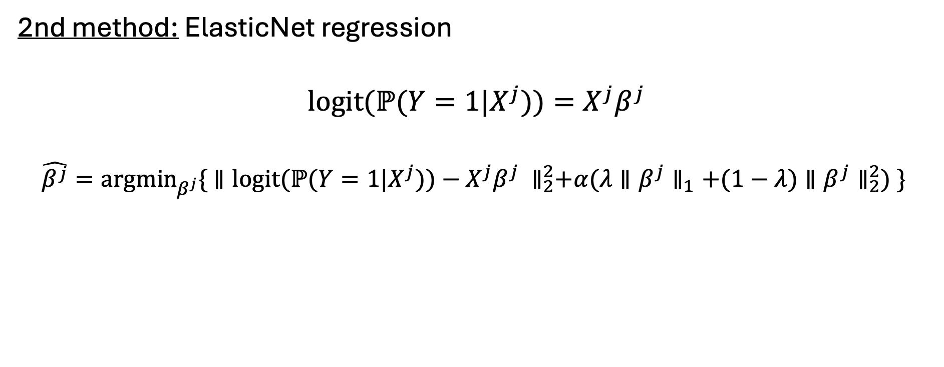
Block representatives
2nd method: ElasticNet regression
$$logit(ℙ(Y=1|X^{j}))=X^{j}β^{j}$$
$$\hat{β^{j}}=argmin_{β^{j}}\{{ ∥logit(ℙ(Y=1|X^{j}))−X^{j}β^{j} ∥}_{2}^{2}+α(λ{∥β^{j}∥}_{1}+(1−λ){∥β^{j}∥}_{2}^{2}) \}$$
Error
LASSO penalty
Ridge penalty
$$1≥α≥0, 1≥λ≥0$$

Slide 9
Block representatives
3rd method: Decision tree based models (XGBoost, RandomForest)
Example:
A ∈ {1, 2, 3}
B ∈ {1, 2, 3, 4, 5}
C ∈ {0, 1}
Binary target
All samples
A=1
A=2
A=3
B ∈ {2, 3, 4}
B =5
C=0
C=1
B=1
C=0
C=1

Slide 10
Block representatives
3rd method: Decision tree based models (XGBoost, RandomForest)
XGBoost
Trains a decision tree
Iterates: training a tree on the gradient of loss of the previous trees (uses logistic loss)
RandomForest:
Multiple trees trained on random subsets of the variables
Predictions averaged at the end

Slide 11
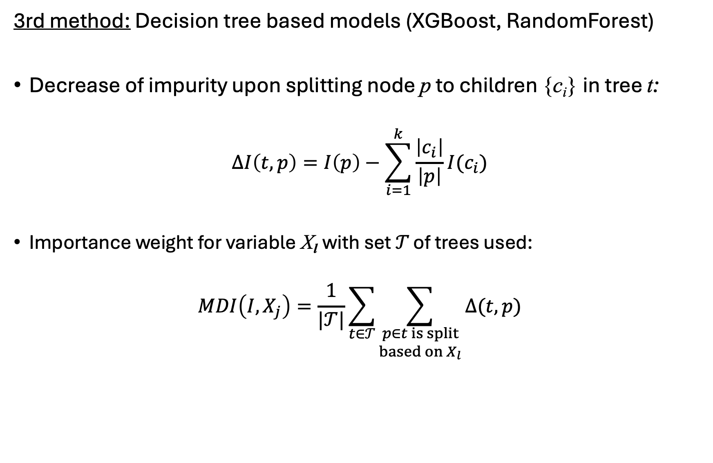
Block representatives
3rd method: Decision tree based models (XGBoost, RandomForest)
Decrease of impurity upon splitting node p to children {c_{i}} in tree t:
$$ΔI\left(t,p\right)=I\left(p\right)−\sum_{i=1}^{k}{\frac{\left|c_{i}\right|}{\left|p\right|}I(c_{i})}$$
Importance weight for variable X_{l} with set 𝒯 of trees used:
$$MDI\left(I, X_{j}\right)=\frac{1}{|𝒯|}\sum_{t∈𝒯}{\sum_{\begin{aligned}p∈t is split \\ based on X_{l}\end{aligned}}{Δ(t,p)}}$$

Slide 12
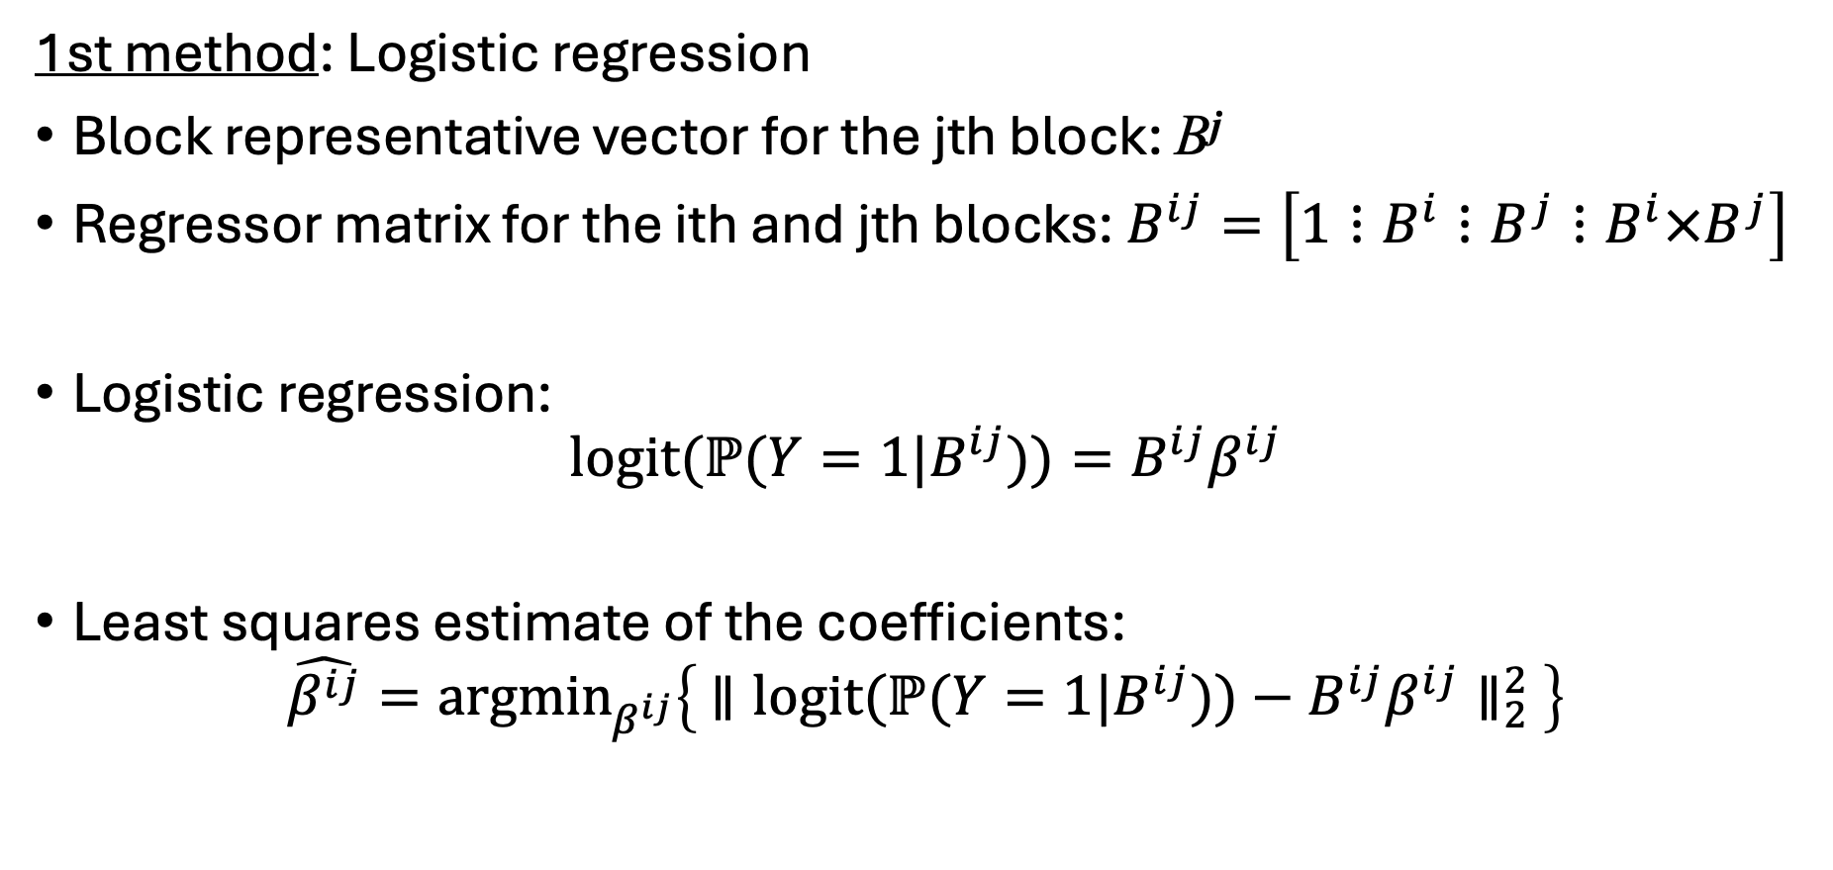
Block-level interactions
1st method: Logistic regression
Block representative vector for the jth block: B^{j}
Regressor matrix for the ith and jth blocks: $B^{ij}=\left[1⋮B^{i}⋮B^{j}⋮B^{i}×B^{j}\right]$
Logistic regression:
$$logit(ℙ(Y=1|B^{ij}))=B^{ij}β^{ij}$$
Least squares estimate of the coefficients:
$$\hat{β^{ij}}=argmin_{β^{ij}}\left\{ ∥{logit(ℙ(Y=1|B^{ij}))−B^{ij}β^{ij}∥}_{2}^{2} \right\}$$

Slide 13
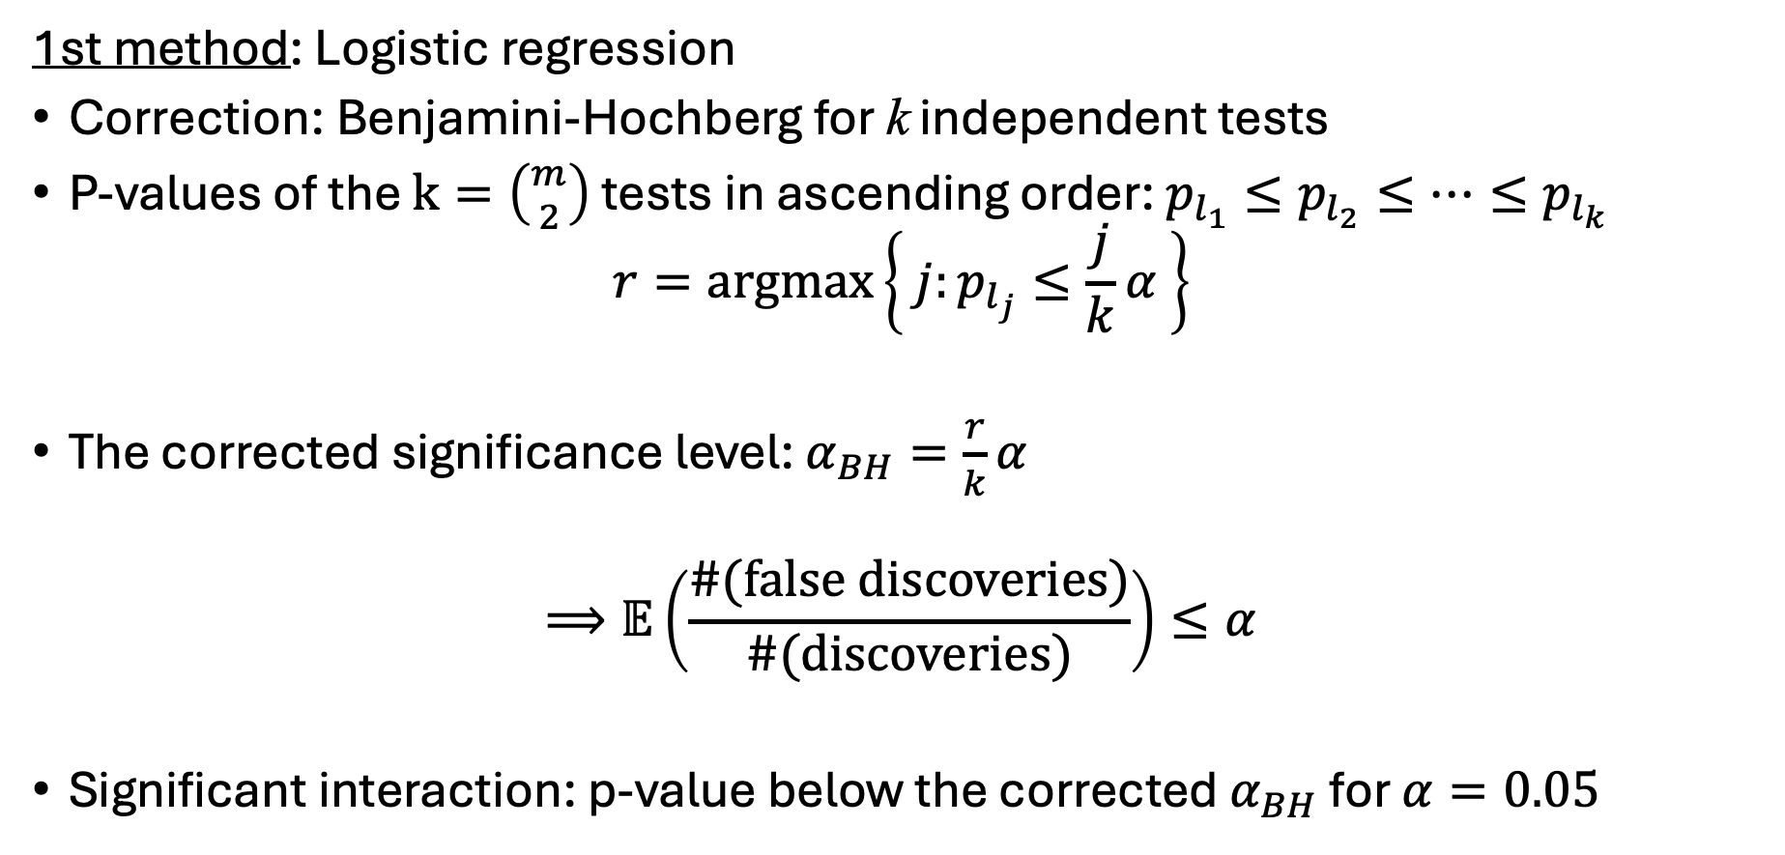
Block-level interactions
1st method: Logistic regression
Correction: Benjamini-Hochberg for k independent tests
P-values of the $k=\left({m \atop 2}\right)$ tests in ascending order: $p_{l_{1}}≤p_{l_{2}}≤…≤p_{l_{k}}$
$$r=argmax\left\{ j:p_{l_{j}}≤\frac{j}{k}α \right\}$$
The corrected significance level: $α_{BH}=\frac{r}{k}α$
$$⟹𝔼\left(\frac{\#(false discoveries)}{\#(discoveries)}\right)≤α$$
Significant interaction: p-value below the corrected $α_{BH}$ for $α=0.05$

Slide 14
Block-level interactions
2nd method: XGBoost
Fitting XGBoost on all the block representatives
Significant: pair’s interaction importance is among the top q%

Slide 15
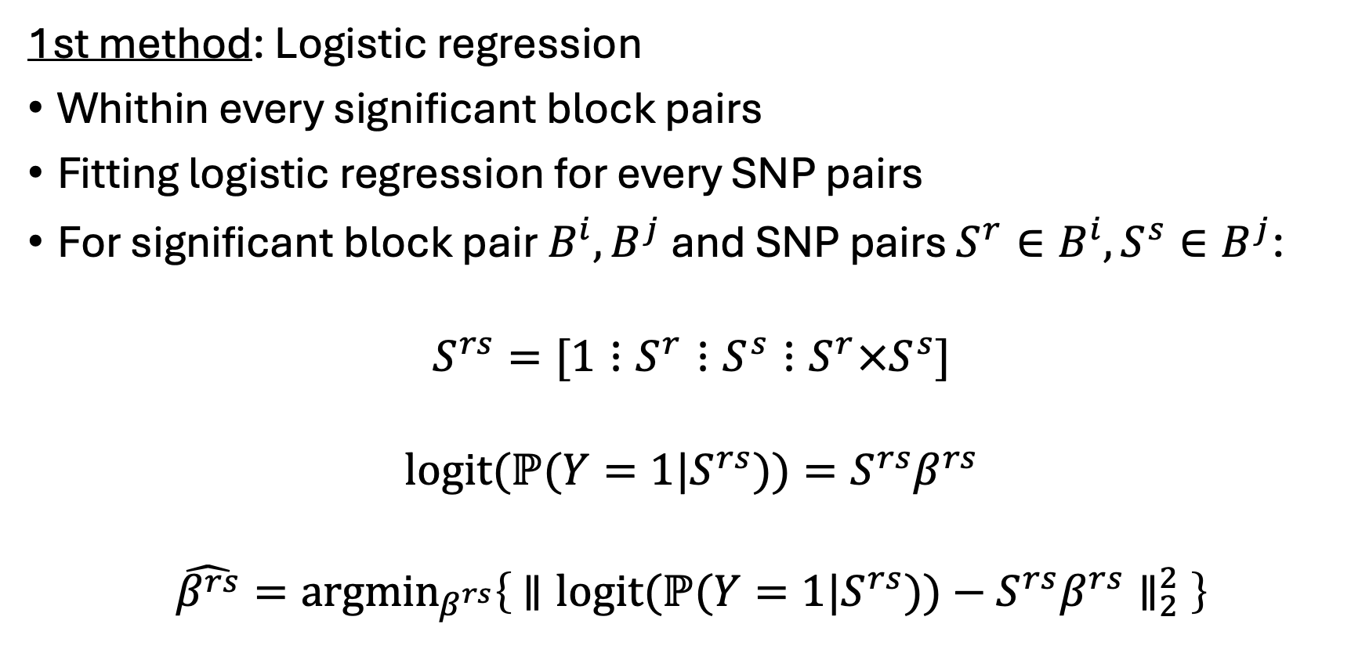
SNP-level interactions
1st method: Logistic regression
Whithin every significant block pairs
Fitting logistic regression for every SNP pairs
For significant block pair $B^{i},B^{j}$ and SNP pairs $S^{r}∈B^{i}, S^{s}∈B^{j}$:
$$S^{rs}=[1⋮S^{r}⋮S^{s}⋮S^{r}×S^{s}]$$
$$logit(ℙ(Y=1|S^{rs}))=S^{rs}β^{rs}$$
$$\hat{β^{rs}}=argmin_{β^{rs}}\left\{ ∥{logit(ℙ(Y=1|S^{rs}))−S^{rs}β^{rs}∥}_{2}^{2} \right\}$$

Slide 16
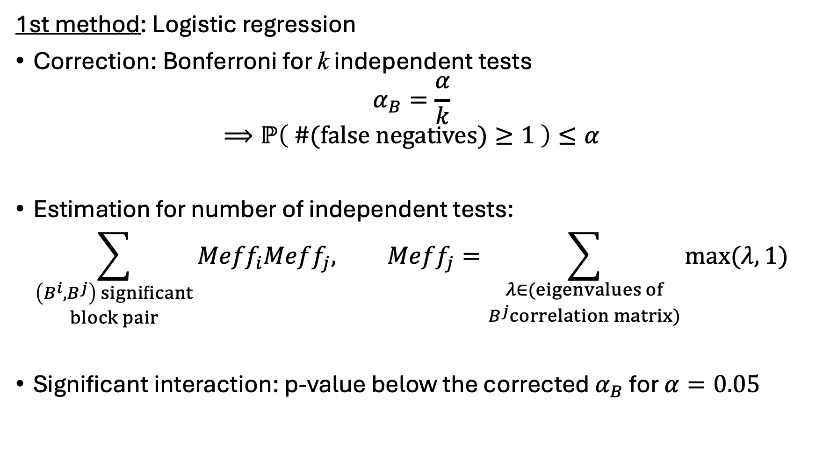
SNP-level interactions
1st method: Logistic regression
Correction: Bonferroni for k independent tests
$$α_{B}=\frac{α}{k}$$
$$⟹ℙ\left( \#(false negatives)≥1 \right)≤α$$
Estimation for number of independent tests:
$$\sum_{\begin{aligned}\left(B^{i}, B^{j}\right) significant \\ block pair\end{aligned}}{{Meff}_{i}Meff_{j}, Meff_{j}=\sum_{\begin{aligned}λ∈(eigenvalues of \\ B^{j}correlation matrix)\end{aligned}}{\max{(λ, 1)}}}$$
Significant interaction: p-value below the corrected $α_{B}$ for $α=0.05$

Slide 17
SNP-level interactions
2nd method: XGBoost
For every significant block pair
Fitting XGBoost on all the SNPs in the block pair
Significant: pair’s interaction importance is among the top q%

Slide 18
Results

Slide 19
References
[1] Molly Przeworski Augustine Kong Alexander I. Young, Stefania Benonisdottir. Deconstructing the sources of genotype-phenotype associations in humans. Science, 365(6460):1396–1400, 2019.
[2] Cooper-Knock J. Stamp J. et al Balvert, M. Considerations in the search for epistasis. Genome Biol, 25(296), 2024.
[3] Yingjie Guo et al. Gene-based testing of interactions using xgboost in genome-wide association studies. Front. Cell Dev. Biol., 9(16):8011–8013, 2021.
[4] McLean G.R. Franke A. Huang, J. wenty years of genome-wide association studies: Health translation challenges and ai opportunities. Eur J Hum Genet, 33:1579–1584, 2025.
[5] Trevor Hastie Hui Zou. Regularization and variable selection via the elastic net. Journal of the Royal Statistical Society Series B: Statistical Methodology, 67(2):301–320, 2005.
[6] Kamali Z. Xie T. et al. Keaton, J.M. Genome-wide analysis in over 1 million individuals of european ancestry yields improved polygenic risk scores for blood pressure traits. Nat Genet, 56:778–791, 2024.
[7] Ji L. Li, J. Adjusting multiple testing in multilocus analyses using the eigenvalues of a correlation matrix. Heredity, 95:221–227, 2005.
[8] Zeggini E. McCarthy MI. Genome-wide association studies in type 2 diabetes. Curr Diab Rep., 9(2):164–171, 2009.
[9] Hadarits O, Harreiter J, Nádasdi A, Kelemen F, Bancher-Todesca D, Komlósi Z, Németh L, Rigó J Jr, Sziller I, Somogyi A, Kautzky-Willer A, Firneisz G, Rosta K, Al-Aissa Z. Association study with 77 snps confirms the robust role for the rs10830963/g of mtnr1b variant and identifies two novel associations in gestational diabetes mellitus development. 2017.
[10] B.S. Shastry. Snps: Impact on gene function and phenotype. Single Nucleotide Polymorphisms. Methods in Molecular Biology, 578, 2009.
[11] Montgomery Slatkin. Linkage disequilibrium–understanding the evolutionary past and mappingthe medical future. Nat Rev Genet, 9(6):477–485, 2008.
[12] Holzinger-E. Dasgupta A. et al. Szymczak, S. A new variable selection method for random forestsin genome-wide association studies. BioData Mining, 9(7), 2016.
[13] Joseph K. Pickrell Tomaz Berisa. Approximately independent linkage disequilibrium blocks inhuman populations. Bioinformatics, 32(2):283–285, 2016.
[14] Robert R H Anholt Trudy F C Mackay. Gregor mendel’s legacy in quantitative genetics. PLoS Biol, 20(7), 2022.
[15] Sadeesh A. Srinivasasainagendra V. et al Vejandla, S.C. Calibrating genome wide significance byminor allele frequency across three major populations. Sci Rep, 15, 2025.

