Slide 1
Image Geolocation: Interim Project Report
Long-term goal: reproduce a PIGEON-like image geolocation system.
This semester: dataset exploration, benchmark construction, and evaluation pipeline.
Practical reason for delay: GPU access became available only recently, so the actual model reproduction is moved to next semester.
Additional research angle: test whether ChatGPT’s OCR-like multimodal reasoning can complement a specialised visual geolocation model.
1

Slide 2
Research Question and Current Status
Core task: image input → model → geographic coordinate output.
Target system: PIGEON, a specialised planet-scale image geolocation model.
Current status: the full reproduction has not started yet because training requires GPU resources.
What has already been built:
  a dataset collection pipeline for geotagged images;
  a manual-but-controlled benchmark with hidden ground truth;
  automatic scoring with haversine distance and summary metrics;
  export of results into structured Excel tables for analysis.
Why this order of work?
Rather than waiting for the GPU environment, I first built the surrounding infrastructure: data collection, hidden ground truth, prediction cleaning, and error computation. This makes the later PIGEON reproduction much easier to evaluate fairly.
2

Slide 3
What PIGEON Contributes
PIGEON does not simply regress latitude and longitude directly.
Instead, it first predicts a geographic region (a geocell), then refines the location.
This is useful because direct global coordinate regression is unstable.
The main ideas in the PIGEON pipeline are:
  semantic geocells;
  CLIP-based visual representations;
  haversine-aware learning/evaluation;
  retrieval-based refinement.
Image input
Visual encoder
Geocell prediction
Refinement
Lat/Lon output
Evaluation style in the paper:
median error and the share of predictions within 1 km, 25 km, 200 km, 750 km and 2500 km.
I reused the same family of metrics in my own benchmark.
3

Slide 4
Dataset Problem and Practical Choice
Source | Strength | Main limitation
Mapillary | Street-level images with GPS | Requires token / API handling
Wikimedia Commons | Freely accessible geotagged images | Heterogeneous; needs filtering
GLDv2 | Useful for landmark recognition | Not an exact coordinate benchmark
PIGEON test data | Best option for fair comparison | Not currently available to me
For the pilot benchmark I chose Wikimedia Commons, because it allowed image + coordinate collection without a private API key.
I collected 169 images, approximately 30 per region.
Not all images were usable: some showed people, interiors, museum scenes or weak geographic information.
Therefore I manually filtered the set and kept only the outdoor / landscape-like images that were useful for geolocation.
4

Slide 5
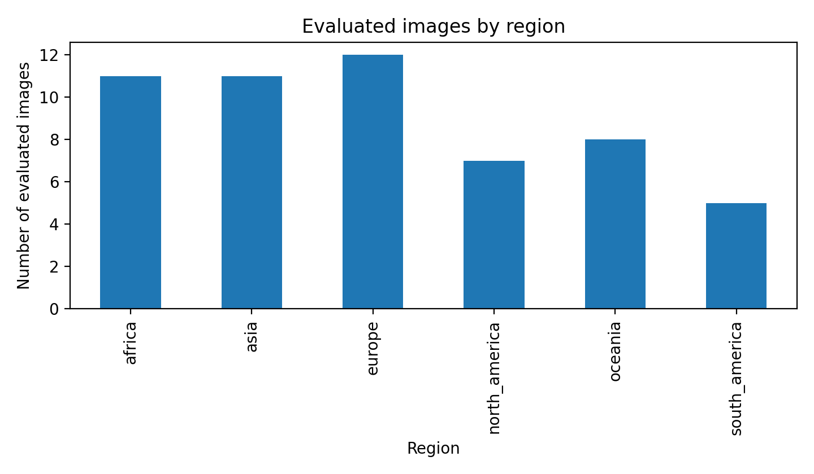

Slide 6
Why Test ChatGPT?
The ChatGPT experiment was not only a fallback while waiting for GPU access.
It also tests a capability that differs from PIGEON: OCR-like reasoning over visible text.
Examples of useful textual clues in geolocation:
  street signs and route signs;
  shop names and advertisements;
  public notices, banners and protest signs;
  language, script and place names.
This suggests a future hybrid idea: combine a specialised visual geolocation model with an OCR-capable multimodal model.
PIGEON-like model
ChatGPT
Strong at learning:
• visual geography
• road / vegetation cues
• architecture
• landscape distribution
Weakness: no explicit OCR component.
Can exploit:
• text in images
• script and language
• landmarks + reasoning
• semantic context
Weakness: not a trained geolocation specialist.
Working hypothesis:
visual geolocation and OCR-based semantic reasoning may complement each other.
5

Slide 7
Pilot Workflow and Evaluation Method
1. Collect images
2. Filter images
3. Upload to ChatGPT
4. Clean outputs
5. Score
Wikimedia Commons API
manual outdoor / landscape selection
10-image batches in Pro interface
CSV cleaning script
haversine distance + summary tables
Important methodological point:
Only the images were shown to ChatGPT. The true coordinates remained hidden in the ground-truth CSV. This made the pilot benchmark a real prediction task rather than a metadata lookup task.
Haversine scoring: compare predicted and true latitude / longitude, then compute distance in kilometres.
6

Slide 8
Current Quantitative Results
Evaluated images
Median error
Mean error
% within 25 km
54
3.58 km
304.17 km
87.04%
Metric | Value
Mean error | 304.17 km
Median error | 3.58 km
Minimum error | 0.003 km
Maximum error | 5235.18 km
% @ 1 km | 29.63%
% @ 25 km | 87.04%
% @ 200 km | 88.89%
% @ 750 km | 92.59%
% @ 2500 km | 94.44%
Interpretation:
The median error is very low, which means that many images were identified accurately. However, the mean error is much larger because a few predictions fail catastrophically. This is why geolocation work usually reports both median error and threshold-based metrics instead of relying on the mean alone.
7

Slide 9
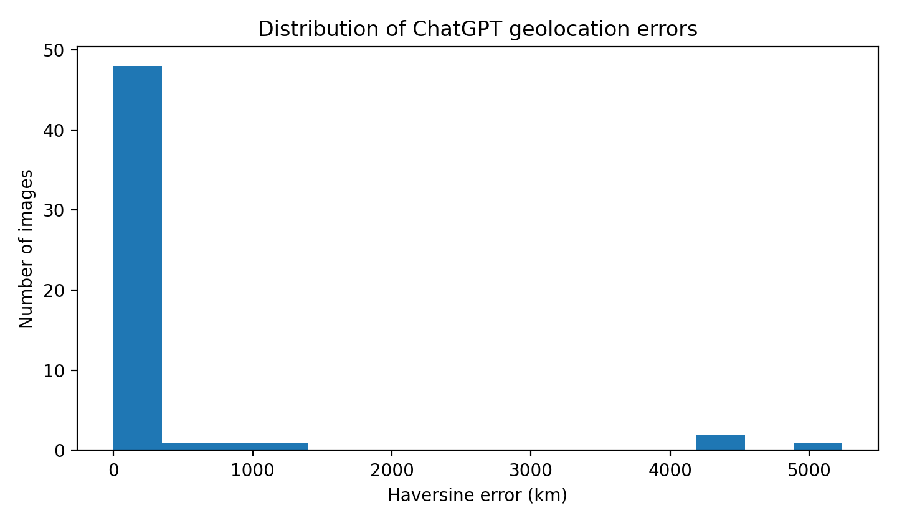

Slide 10
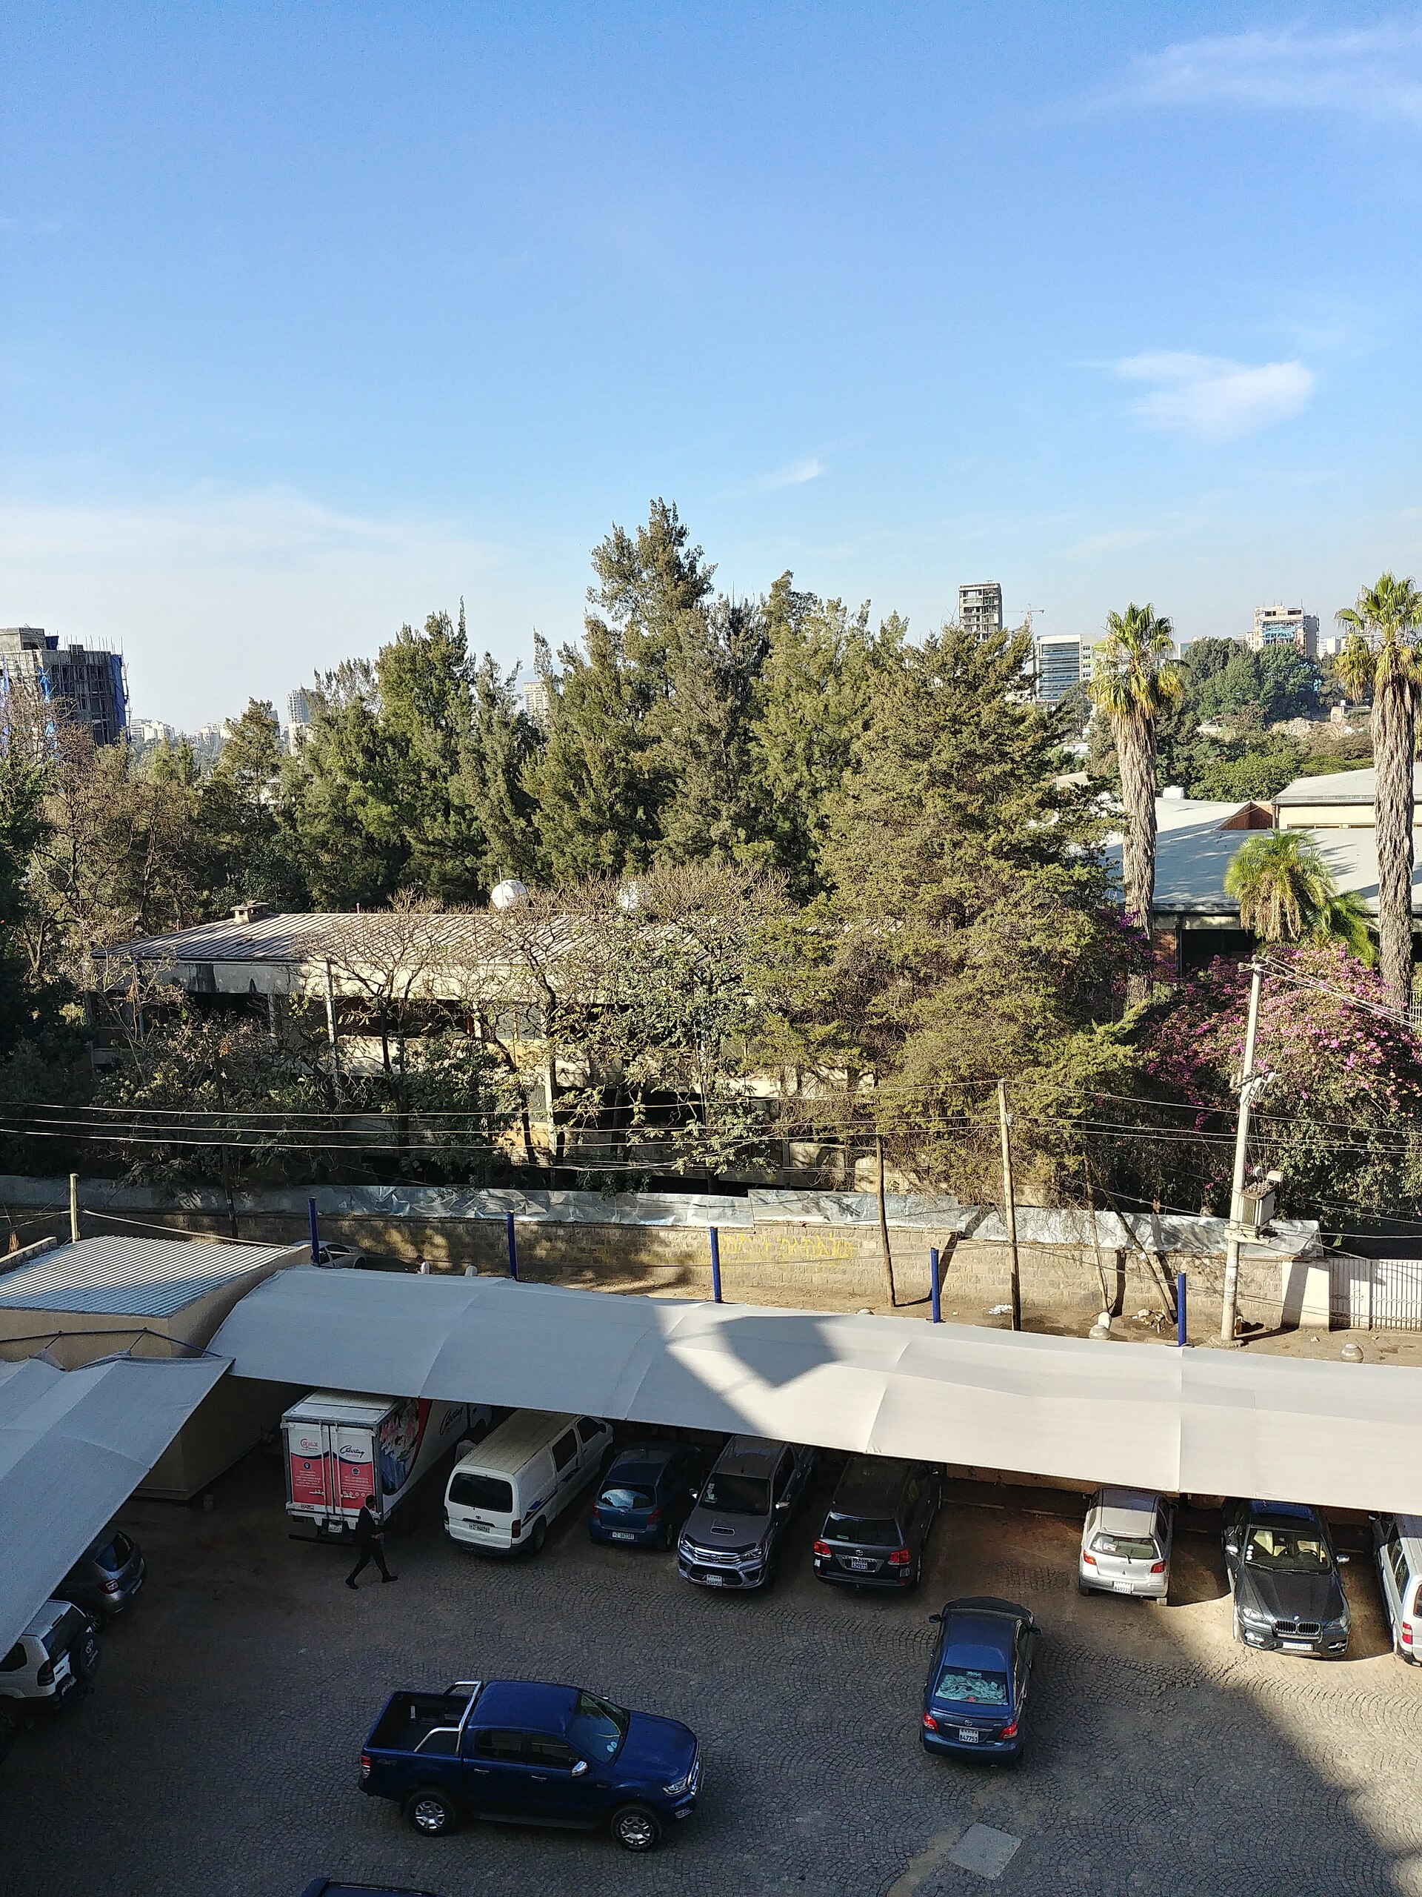
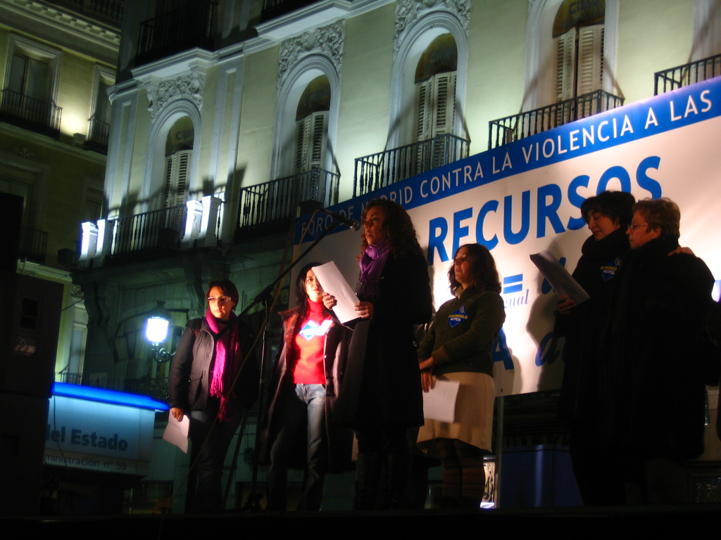
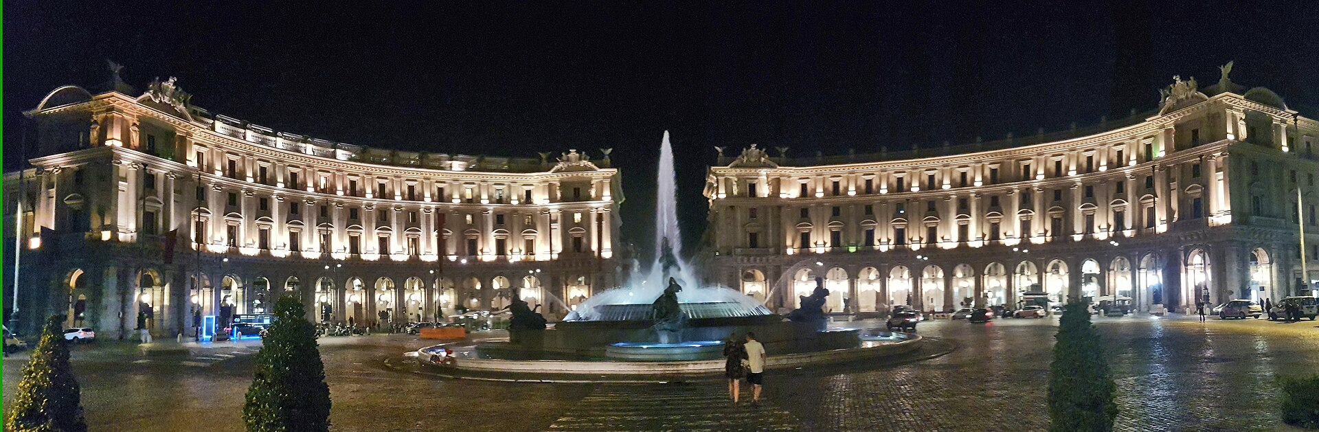
Example Predictions Backing Up the Results
Text / OCR clue
Landmark / strong visual clue
Large failure
Image: img_000131.jpg
True: (40.417, -3.704)
Predicted: (40.417, -3.704)
Country guess: Spain
Reason: madrid protest stage at puerta del sol
Error: 0.03 km
Image: img_000144.jpg
True: (41.903, 12.496)
Predicted: (41.903, 12.496)
Country guess: Italy
Reason: piazza della repubblica fountain
Error: 0.02 km
Image: img_000007.jpg
True: (-33.925, 18.424)
Predicted: (9.018, 38.758)
Country guess: Ethiopia
Reason: addis ababa urban trees and highrises
Error: 5235.18 km
8

Slide 11
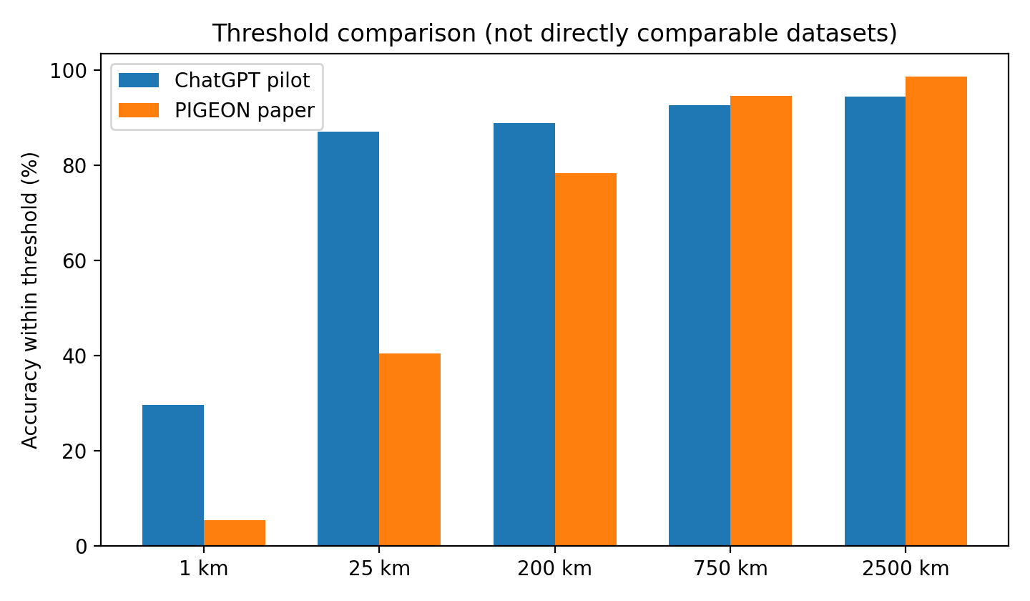
ChatGPT Pilot vs PIGEON: Useful but Not Yet Fair
Metric | ChatGPT pilot | PIGEON | Comment
Dataset | Filtered Commons; n=54 | Street View holdout; n=5000 | not directly comparable
Input | single images | 4-image panorama | PIGEON sees more context
Mean error | 304.17 km | 251.6 km | similar order; different data
Median error | 3.58 km | 44.35 km | Commons likely landmark-biased
% @ 1 km | 29.63% | 5.36% | ChatGPT benefits from landmarks/OCR
% @ 25 km | 87.04% | 40.36% | not a fair benchmark yet
% @ 200 km | 88.89% | 78.28% | broader regional accuracy
% @ 750 km | 92.59% | 94.52% | country-level ballpark
% @ 2500 km | 94.44% | 98.56% | continent-level ballpark
The table is informative, but the conclusion must be cautious: the datasets are very different. The pilot result is encouraging, but it does not show that ChatGPT is globally better than PIGEON. It mainly shows that a fairer comparison is needed.
9

Slide 12
Next Semester Plan and Takeaway
Now that GPU access is available, the next phase will focus on the actual PIGEON-style reproduction.
Planned next steps:
  set up the full GPU environment;
  inspect and adapt the PIGEON codebase;
  build a cleaner street-level / outdoor dataset;
  train a baseline geocell classifier;
  compare the trained model with PIGEON on a fair dataset.
Main conceptual takeaway: the most promising long-term direction is probably a hybrid system combining a PIGEON-like visual prior with ChatGPT-style OCR and semantic reasoning.
Takeaway for the talk
What is already done:
• pilot benchmark works
• hidden ground truth works
• haversine scoring works
• Excel reporting works
What comes next:
GPU-based PIGEON reproduction and a fairer comparison.
10

Slide 13
Thank you for your attention!

