Slide 1
Unit distance graphs

Slide 2
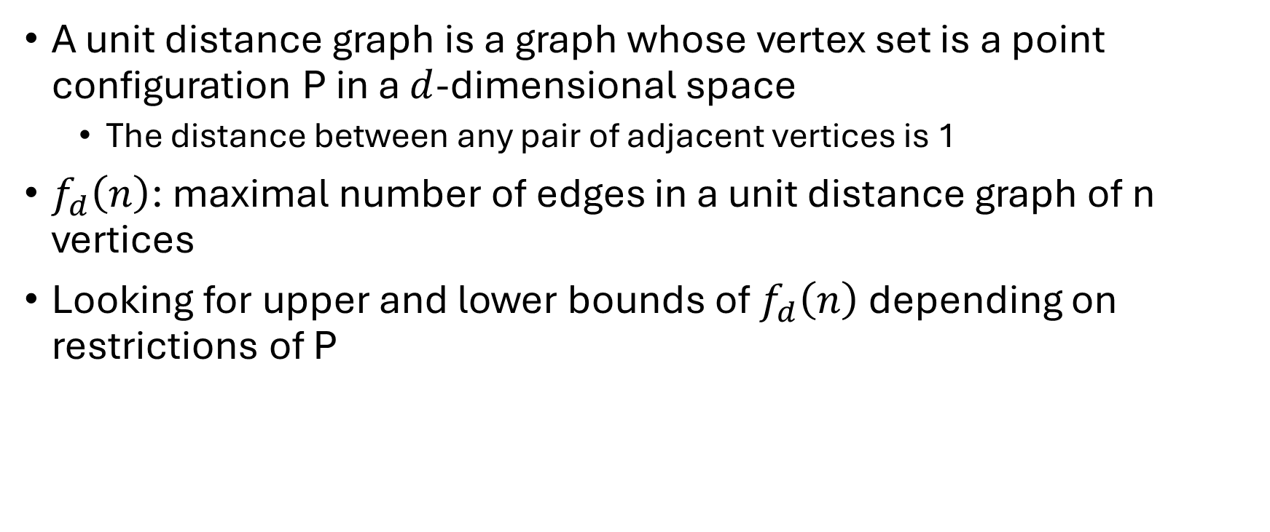
Definitions
A unit distance graph is a graph whose vertex set is a point configuration P in a $d$-dimensional space
The distance between any pair of adjacent vertices is 1
$f_{d}\left(n\right)$: maximal number of edges in a unit distance graph of n vertices
Looking for upper and lower bounds of $f_{d}\left(n\right)$ depending on restrictions of P

Slide 3
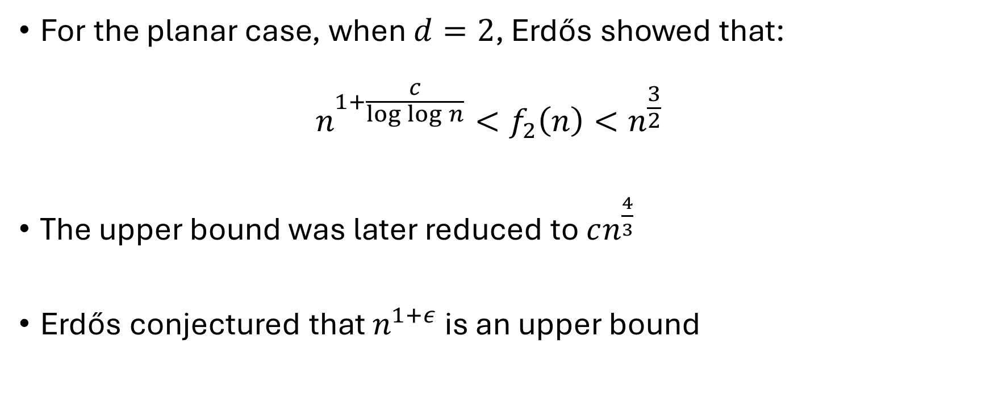
Erdős’ original results
For the planar case, when $d=2$, Erdős showed that: $n^{1+\frac{c}{\log{\log{n}}}}<f_{2}\left(n\right)<n^{\frac{3}{2}}$
The upper bound was later reduced to $cn^{\frac{4}{3}}$
Erdős conjectured that $n^{1+ε}$ is an upper bound

Slide 4
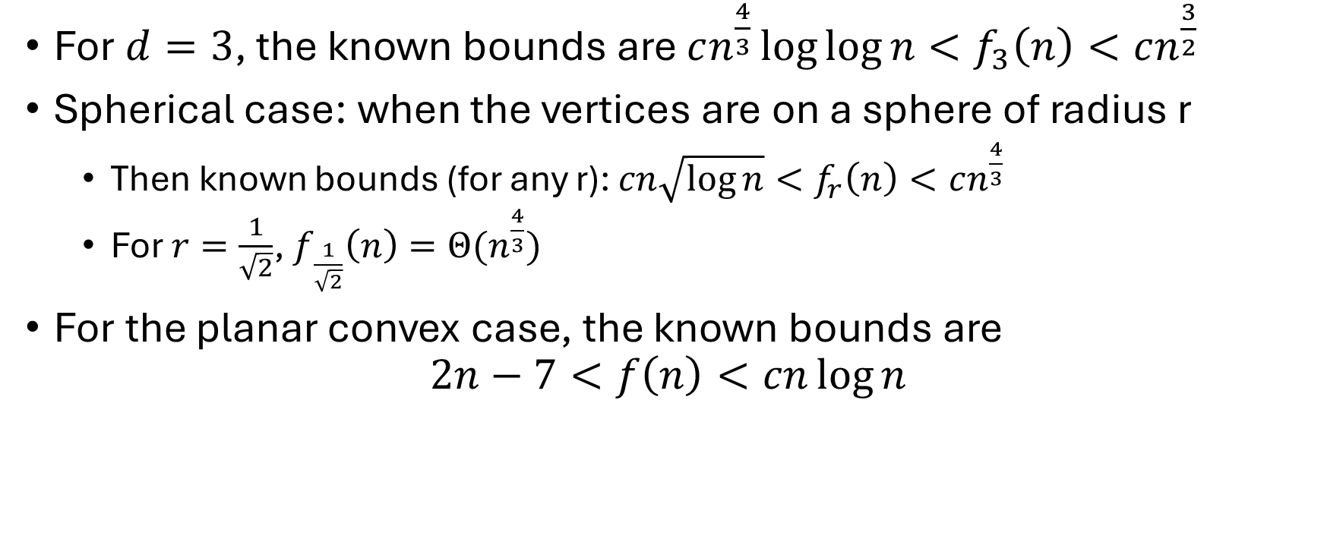
Other cases
For $d=3$, the known bounds are $cn^{\frac{4}{3}}\log{\log{n}}<f_{3}\left(n\right)<cn^{\frac{3}{2}}$
Spherical case: when the vertices are on a sphere of radius r
Then known bounds (for any r): $cn\sqrt{\log{n}}<f_{r}\left(n\right)<cn^{\frac{4}{3}}$
For $r=\frac{1}{\sqrt{2}}$, $f_{\frac{1}{\sqrt{2}}}\left(n\right)=Θ(n^{\frac{4}{3}})$
For the planar convex case, the known bounds are $2n−7<f\left(n\right)<cn\log{n}$

Slide 5
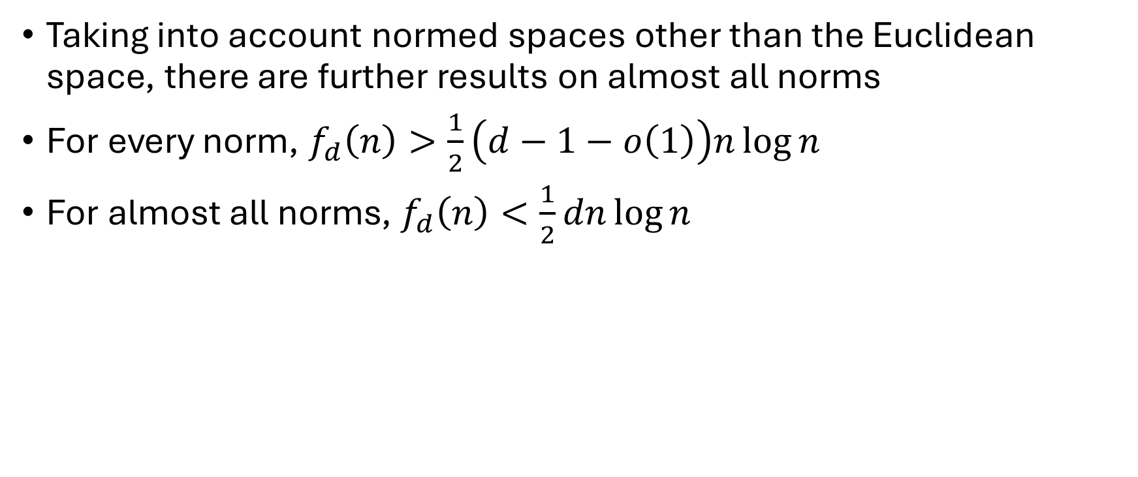
Typical norms
Taking into account normed spaces other than the Euclidean space, there are further results on almost all norms
For every norm, $f_{d}\left(n\right)>\frac{1}{2}\left(d−1−o\left(1\right)\right)n\log{n}$
For almost all norms, $f_{d}\left(n\right)<\frac{1}{2}dn\log{n}$

Slide 6
References
P. Erdős. “On Sets of Distances of n Points”. In: The American Mathematical Monthly 53.5 (1946), pp. 248–250.
László Székely. “Crossing Numbers and Hard Erdos Problems in Discrete Geometry”. In: Combinatorics, Probability and Computing 6 (Sept. 1997), pp. 353–358.
János Pach. “Finite Point Configurations”. In: Handbook of Discrete and Computational Geometry, Second Edition. Ed. by Jacob E. Goodman and Joseph O’Rourke. Chapman and Hall/CRC, 2004, pp. 3–24.
Noga Alon, Matija Bucic, and Lisa Sauermann. Unit and distinct distances in typical norms. 2024. arXiv: 2302.09058 [math.CO]
Herbert Edelsbrunner and Péter Hajnal. “A lower bound on the number of unit distances between the vertices of a convex polygon”. In: Journal of Combinatorial Theory, Series A 56.2 (1991), pp. 312–316.

Slide 7
Thank you for your attention!

