Slide 1
Projective Fraïssé theory and the Pseudo-arc
Kozári Dominik

Slide 2
Classical Fraïssé theory
Projective Fraïssé theory and the Pseudo-arc - Kozári Dominik
A Fraïssé class is a nonempty class 𝒦 of first order ℒ-structures for which the following hold:
𝒦 contains only finitely generated structures,
𝒦 contains countably many isomorphism types,
𝒦 is closed under isomorphism,
𝒦 is closed under taking finitely generated substructures,
𝒦 satisfies the Joint Embedding Property,
𝒦 satisfies the Amalgamation Property.

Slide 3
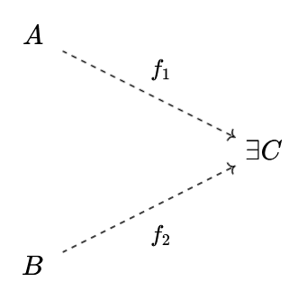
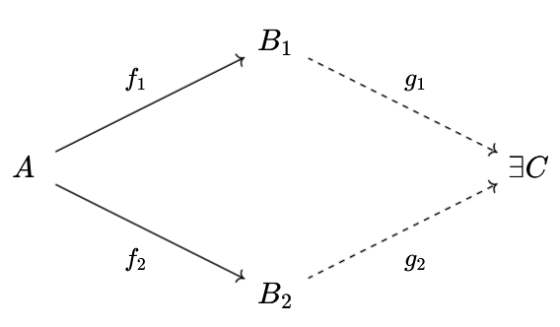
Classical Fraïssé theory
Projective Fraïssé theory and the Pseudo-arc - Kozári Dominik
Joint Embedding Propetry (JEP)
Amalgamation Propetry (AP)

Slide 4

The theorem of Fraïssé
Projective Fraïssé theory and the Pseudo-arc - Kozári Dominik
For a Fraïssé class 𝒦, there exists a unique, up to isomorphism, countable ultrahomogeneous ℒ-structure M with Age(M)=𝒦.
This M is called the Fraïssé limit of 𝒦, and we can construct M as a direct limit of structures in 𝒦:
We shall build a dual version of Fraïssé theory.

Slide 5

Projective Fraïssé theory
Projective Fraïssé theory and the Pseudo-arc - Kozári Dominik
Topological ℒ-structure
Functions are continuous, relations are closed
Compact, second countable, 0-dimensional
Epimorphism („reversed embedding”)
Continuous surjective homomorphism
A tuple in relation R has a preimage tuple in relation R
Inverse limit
Infinite sequences compatible with epimorphisms

Slide 6
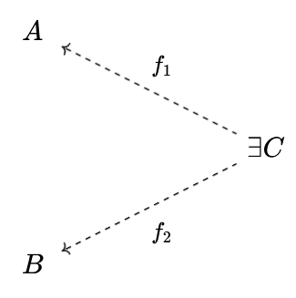
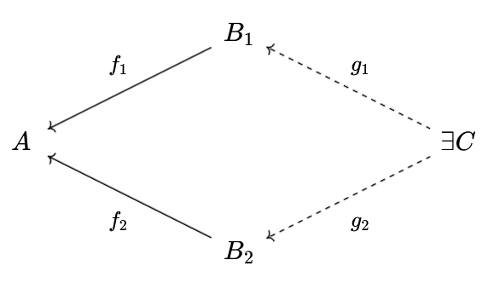
Projective Fraïssé theory
Projective Fraïssé theory and the Pseudo-arc - Kozári Dominik
P. Joint Embedding Propetry (PJEP)
P. Amalgamation Propetry (PAP)

Slide 7
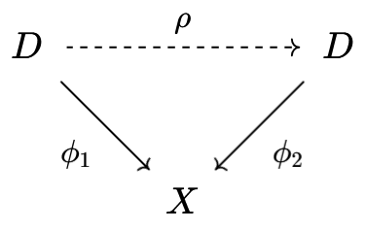
The Projective Fraïssé theorem
Projective Fraïssé theory and the Pseudo-arc - Kozári Dominik
For a Projective Fraïssé class ∆, there exists a unique, up to isomorphism, topological ℒ-structure D, such that:
(P1) There is an epimorphism from D to any structure X of ∆, this can be thought of as the „reverse” of Age(M)=𝒦,
(P2) Every open cover of D can be refined by an epimorphism D⟶X,
(P3)
Holds for any X in ∆, where ρ is an automorphism.
This property is projective homogeneity, the „reverse” of ultrahomogeneity.

Slide 8
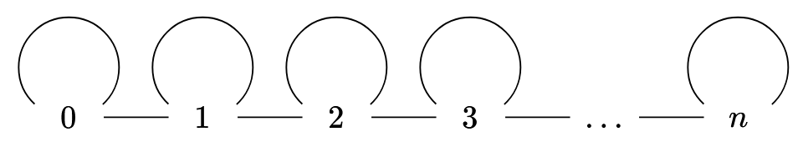
Finite linear graphs
Projective Fraïssé theory and the Pseudo-arc - Kozári Dominik
Our language ℒ consists only of the binary (graph) relation R
Our Projective Fraïssé class ∆₀ consists of every finite D for which:
R^{D} is symmetric,
R^{D} is reflexive,
Each vertex has 2 or 3 neighbors,
Exactly 2 vertices have 2 neighbors,
The graph is connected.
D is a graph with loops on every vertex
The graph is linear

Slide 9
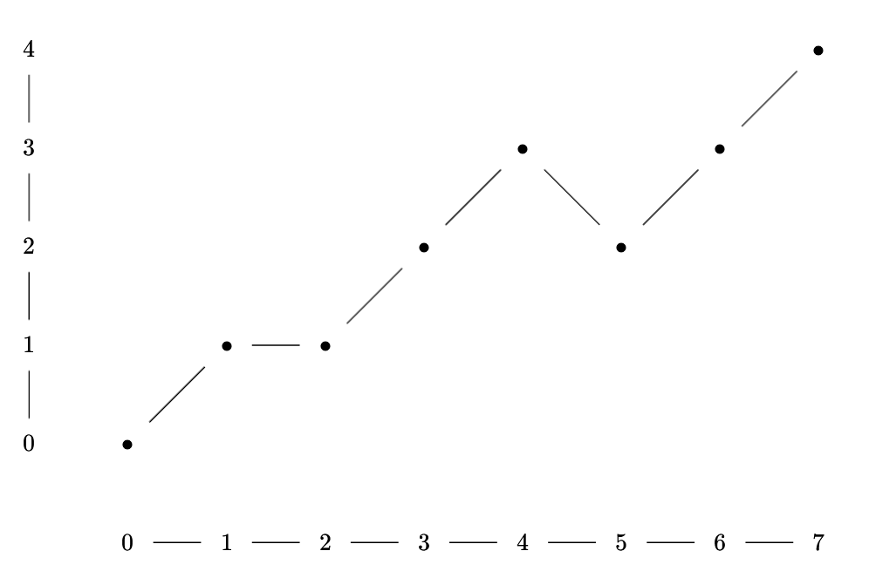
Finite linear graphs
Projective Fraïssé theory and the Pseudo-arc - Kozári Dominik
Epimorphisms are „discrete mountains”.
An example of an epimorphism from 7⟶4:

Slide 10
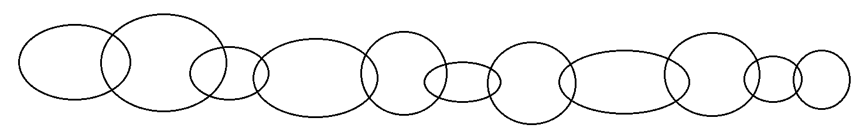
The Pseudo-arc
Projective Fraïssé theory and the Pseudo-arc - Kozári Dominik
Continuum: Nonempty connected compact metrizable space
Indecomposable: Is not the union of 2 proper subcontinua
Hereditarily indecomposable: Subcontinua are indecomposable
Chainable: For every ε>0, it has an open cover that is an „ε-chain”:
Bing’s theorem: The exists a unique, up to homeomorphism, hereditarily indecomposable chainable continuum, and we call this the Pseudo-arc.

Slide 11
Finite linear graphs and the Pseudo-arc
Projective Fraïssé theory and the Pseudo-arc - Kozári Dominik
Lemma: If D is a topological ℒ -structure that satisfies (P2), and R^{D} is an equivalence relation with classes of size at most 2, then D/R^{D} is chainable.
Lemma: For the projective Fraïssé limit P of ∆₀, R^{P} is such a relation, and P/R^{P} is hereditarily indecomposable.
It follows (by Bing’s theorem) that P/R^{P} is the Pseudo-arc.
We call P the pre-Pseudo-arc, and P/R^{P}=P the Pseudo-arc.

Slide 12
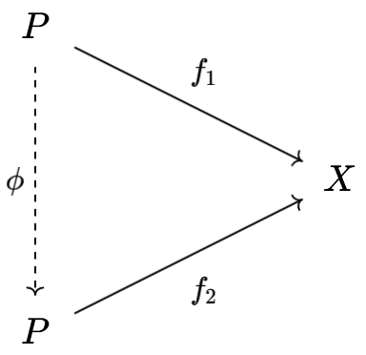
Two nice properties of the Pseudo-arc
Projective Fraïssé theory and the Pseudo-arc - Kozári Dominik
Every chainable continuum is a continuous image of the Pseudo-arc.
For any chainable continuum (X,d), and any ε>0, the following diagram commutes with error <ε with respect to d:
Formally, d_{sup}(f₁ , f₂◦φ) < ε
This property is a kind of approximate projective homogeneity, and this characterizes the Pseudo-arc.
Homeo(P) is dense in Surj(P) !

Slide 13
Thank you for your attention!

