Slide 1
Modern statistics in medical and genetic research
Somogyi Dalma
Supervisor: Dr. Firneisz Gábor

Slide 2
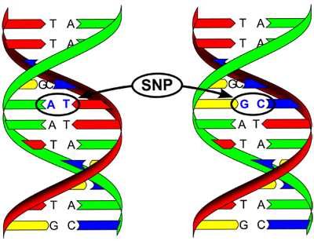
Background in genetics
https://europe.sasso-poultry.com/en/news/introducing-the-new-multi-species-snp-chip-sasso/

Slide 3
The model
Effects of individual SNPs in the development of a disease
Explanatory variable: the SNP – binary
Target variable: if the disease is diagnosed – binary
Covariates: additionial variables – binary or continuous

Slide 4
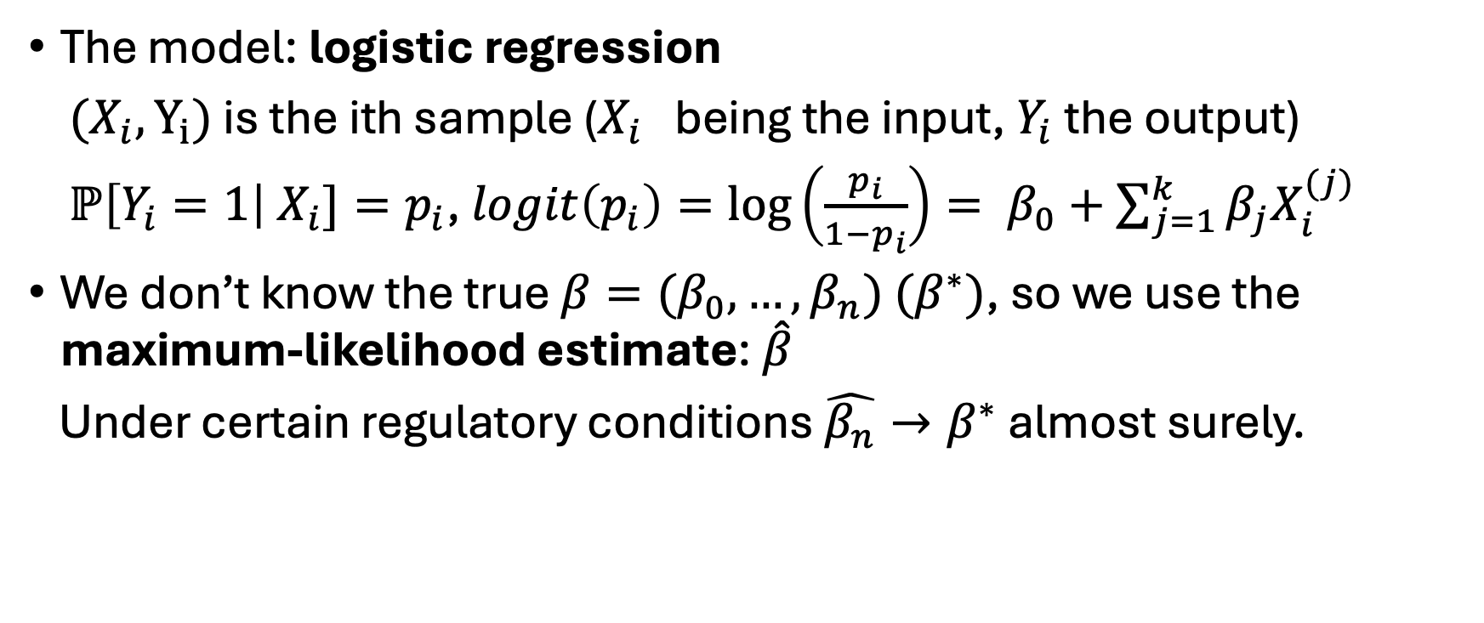
The model
The model: logistic regression
${(X}_{i}, Y_{i})$ is the ith sample ($X_{i}$ being the input, $Y_{i}$ the output)
$ℙ\left[Y_{i}=1\right| X_{i}]=p_{i}$, $logit\left(p_{i}\right)=\log\left(\frac{p_{i}}{1−p_{i}}\right)= β_{0}+\sum_{j=1}^{k}{β_{j}X_{i}^{(j)}}$
We don’t know the true $β=(β_{0},…,β_{n})$ $(β^{∗})$, so we use the maximum-likelihood estimate: $\hat{β}$
Under certain regulatory conditions $\hat{β_{n}}→β^{∗}$ almost surely.

Slide 5
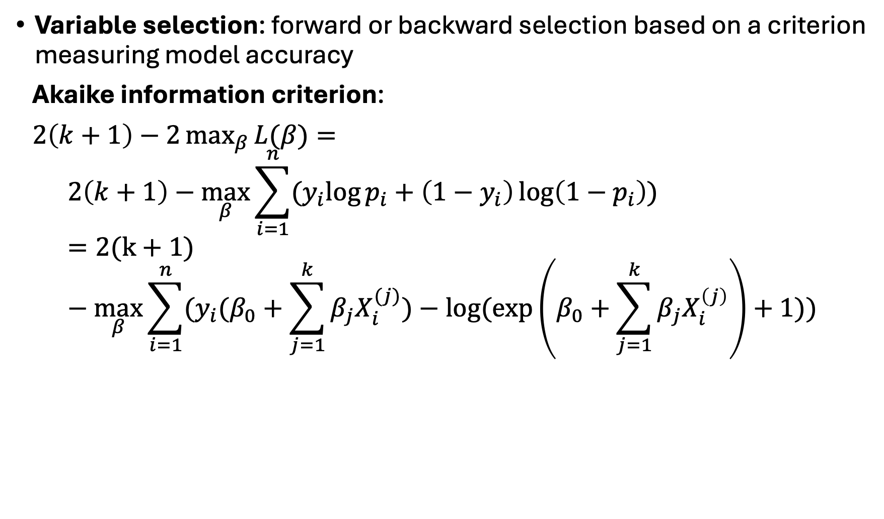
Dimension reduction
Variable selection: forward or backward selection based on a criterion measuring model accuracy
Akaike information criterion:
$2\left(k+1\right)−2\max_{β}{L(β)}=$
$$2\left(k+1\right)−\max_{β}{\sum_{i=1}^{n}{{(y}_{i}\log{p_{i}}+\left(1−y_{i}\right)\log\left(1−p_{i}\right)}})=2(k+1)−\max_{β}{\sum_{i=1}^{n}{(y_{i}(β_{0}+\sum_{j=1}^{k}{β_{j}X_{i}^{(j)}})−log⁡(\exp\left(β_{0}+\sum_{j=1}^{k}{β_{j}X_{i}^{\left(j\right)}}\right)+1))}}$$

Slide 6
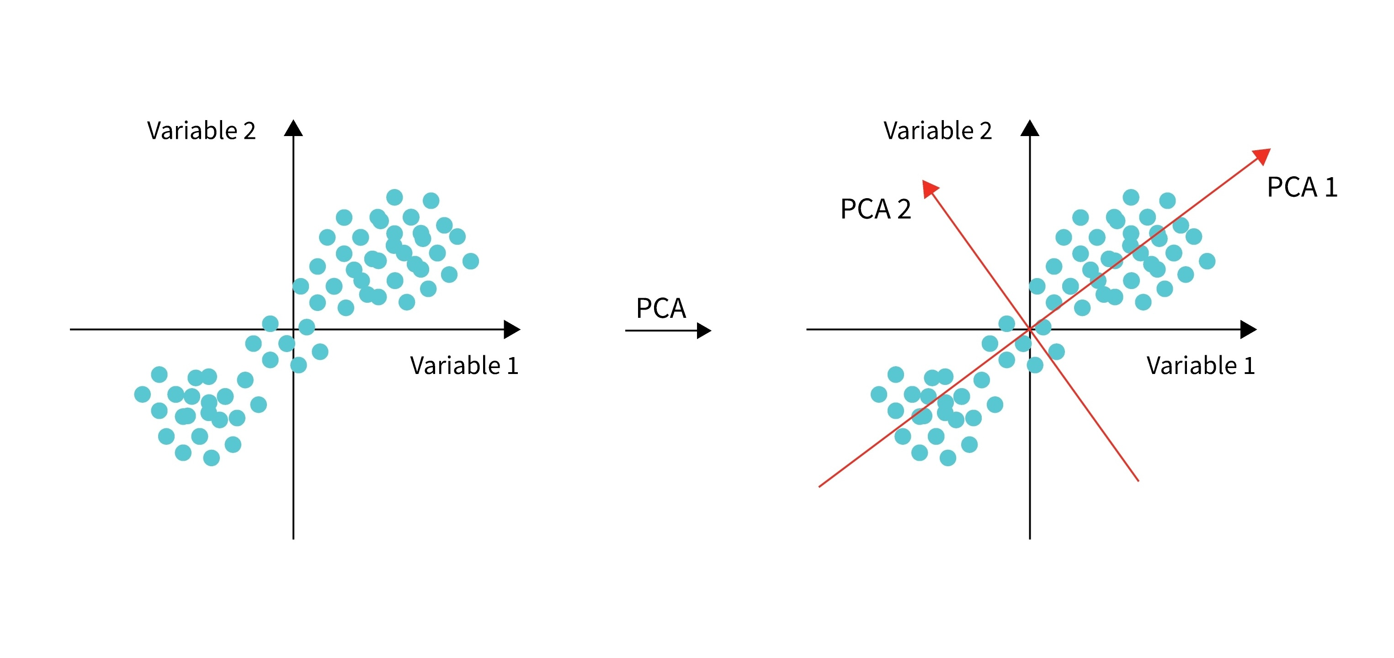

Dimension reduction
Principal component analysis:
$u_{i}=\arg{\max\left(𝔻\left[u^{T}X\right]\right| \left|u_{i}\right|=1, u_{i}⊥\{u_{1},…,u_{i−1}\})}$
https://www.scaler.com/topics/nlp/what-is-pca/

Slide 7
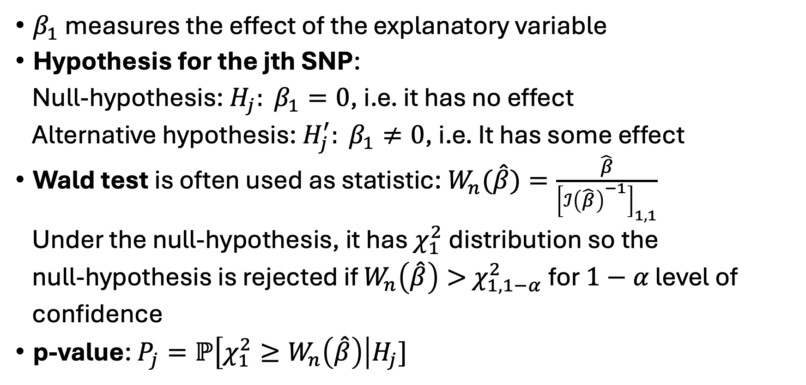
Corrections
$β_{1}$ measures the effect of the explanatory variable
Hypothesis for the jth SNP:
Null-hypothesis: $H_{j}: β_{1}=0$, i.e. it has no effect
Alternative hypothesis: $H_{j}^{′}: β_{1}≠0$, i.e. It has some effect
Wald test is often used as statistic: $W_{n}(\hat{β})=\frac{\hat{β}}{{\left[ℐ{\left(\hat{β}\right)}^{−1}\right]}_{1,1}}$
Under the null-hypothesis, it has $χ_{1}^{2}$ distribution so the
null-hypothesis is rejected if $W_{n}\left(\hat{β}\right)>$ $χ_{1, 1−α}^{2}$ for $1−α$ level of
confidence
p-value: $P_{j}=ℙ\left[χ_{1}^{2}≥W_{n}\left(\hat{β}\right)\right|H_{j}]$

Slide 8
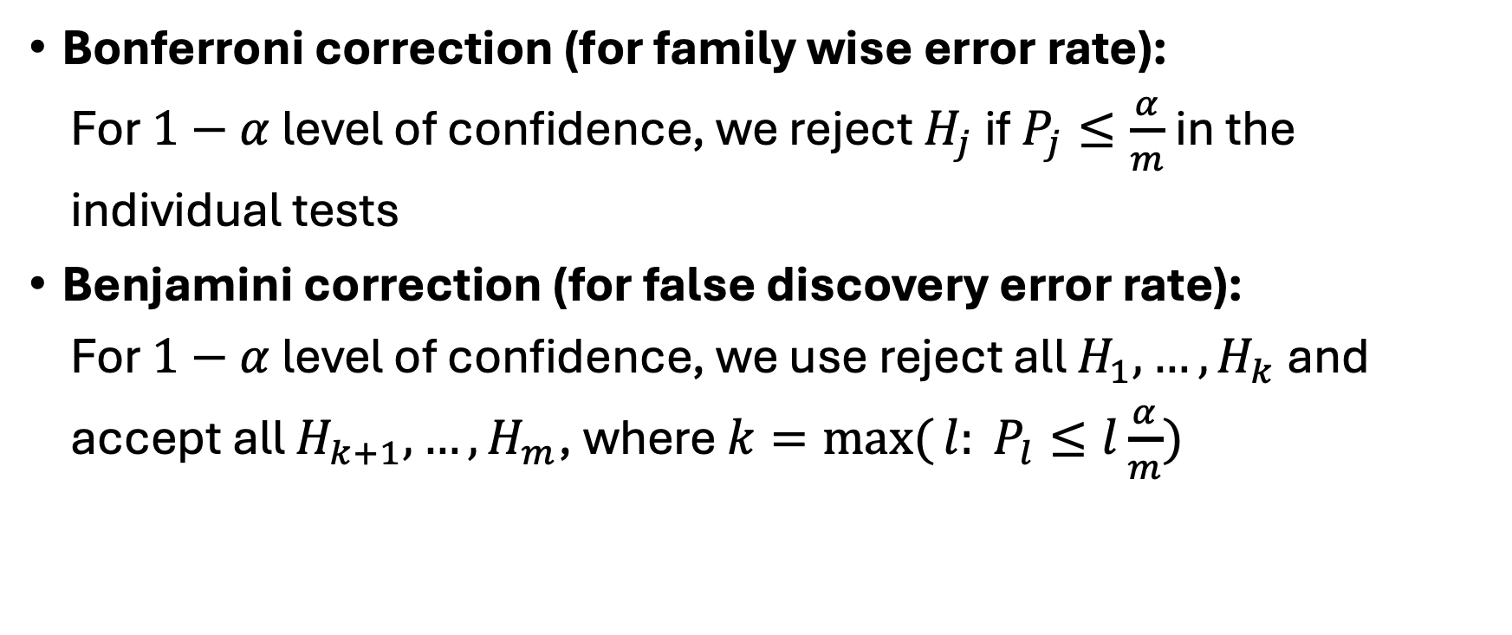
Corrections
Bonferroni correction (for family wise error rate):
For $1−α$ level of confidence, we reject $H_{j}$ if $P_{j}≤\frac{α}{m}$ in the
individual tests
Benjamini correction (for false discovery error rate):
For $1−α$ level of confidence, we use reject all $H_{1},…, H_{k}$ and
accept all $H_{k+1},…,H_{m}$, where $k=\max{(}{l: P}_{l}≤l\frac{α}{m})$

Slide 9
Literature
Balázs Csanád Csáji : Statistical Learning Theory [notes for statistical learning theory, 2025]
Balázs Csanád Csáji : Matematikai statisztika [notes for Mathematical Statistics, 2025]
https://www.statlect.com/fundamentals-of-statistics/Wald-test
https://en.wikipedia.org/wiki/Family-wise error rate
https://en.wikipedia.org/wiki/False discovery rate
Gábor Firneisz et al.: Association Study with 77 SNPs Confirms the Robust Role for the rs10830963/G of MTNR1B Variant and Identifies Two Novel Associations in Gestational Diabetes Mellitus Development
Alan Kuang et al.: Multi-ancestry genome-wide association analyses: a comparison of meta- and mega-analyses in the Hyperglycemia and Adverse Pregnancy Outcome (HAPO) study
Jinyoung Byun et al.:Ancestry inference using principal component analysis and spatial analysis: a distance-based analysis to account for population substructure
Nobuyuki Horita, Takeshi Kaneko: Genetic model selection for case-control study and meta-analysis
Dr. Firneisz Gábor, Nemes A. Botond, Dr. Németh László, Dr. Nádasdi Ákos, Prof. Dr. Benyó Zoltán: Association of Mode of Delivery and Birth Order with Neonatal Cord Blood Hyperinsulinemia [preprint]

