Slide 1
Knowledge Graphs and
Retrieval-Augmented
Generation
Adrienn Molnár
Supervisor: Adrián Csiszárik
Eötvös Loránd University
2025.01.09.

Slide 2
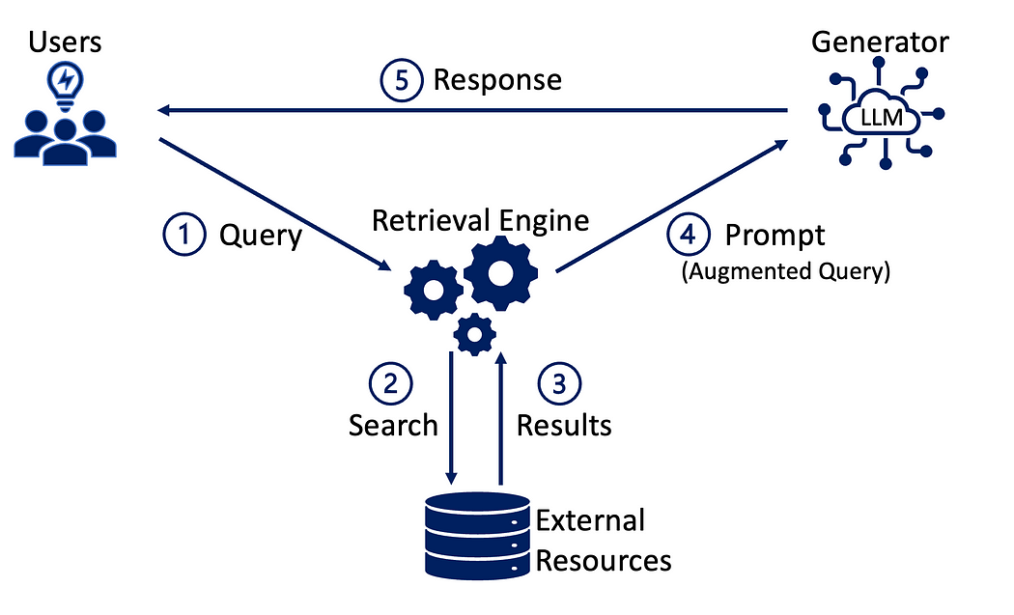
RAG Model

Slide 3
Previous Project
Evaluated the performance of a RAG model in the context of question answering.
Introduced noise into the database to simulate errors commonly encountered during Optical Character Recognition (OCR) processes.
Goal: assess how well the RAG model can retrieve relevant documents and answer questions when the database is compromised with OCR-like noise
Recall: 85% (202 correct contexts out of 237)
Correct answers: 183 out of 237 -> 77%

Slide 4
Goal of the Project
Integrate knowledge graphs with RAG to improve:
Retrieval accuracy through structured relationships.
Contextual understanding for complex, global questions.
Question:
Can knowledge graphs independently improve RAG performance?

Slide 5
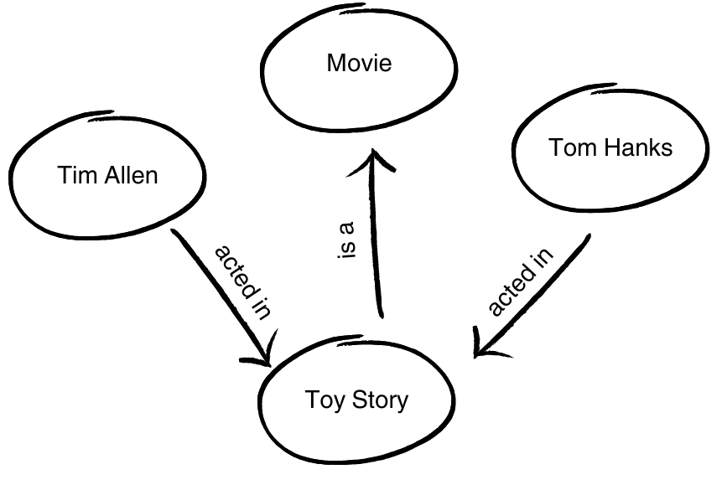
Knowledge Graphs
A knowledge graph is a structured representation of information where:
Nodes = Entities (e.g., people, places, concepts).
Edges = Relationships between entities (e.g., "directed by," "is part of").
Example: A graph connecting movies,
directors, and actors.

Slide 6
How knowledge graphs work?
Entity extraction: Identify entities from raw data (e.g., names, locations).
Relationship identification: Define connections using rules or ontologies (e.g., "works at," "located in").
Graph construction: Organize nodes and edges, enriched with attributes and metadata.
Query processing: Use graph traversal techniques (e.g., Cypher queries) for reasoning and retrieval.

Slide 7
Pros and Cons
Pros of knowledge graphs:
Semantic enrichment: Captures and represents relationships between data points.
Scalability: Can handle large datasets with proper indexing and optimization.
Cross-document reasoning: Handles multi-hop queries effectively.
Improved contextual accuracy: Provides rich, interconnected contexts for queries.
Noise resilience: Structured format is robust to incomplete or noisy data.

Slide 8
Pros and Cons
Cons of knowledge graphs:
Complexity: Requires effort to build and maintain.
Scalability challenges: Large, complex graphs can be computationally intensive.
Dynamic data issues: Adapting to real-time updates can be challenging.
Dependence on data quality: Errors in entity extraction or relationships propagate.

Slide 9
Project Pipeline
Data preparation: Transforming the SQuAD dataset into graph structures.
Graph construction: Neo4j used for storage and queries. Nodes enriched with metadata and embeddings.
Retrieval methods:
Structured retrieval – entity-based
Unstructured retrieval – vector similarity
Hybrid method combining both

Slide 10
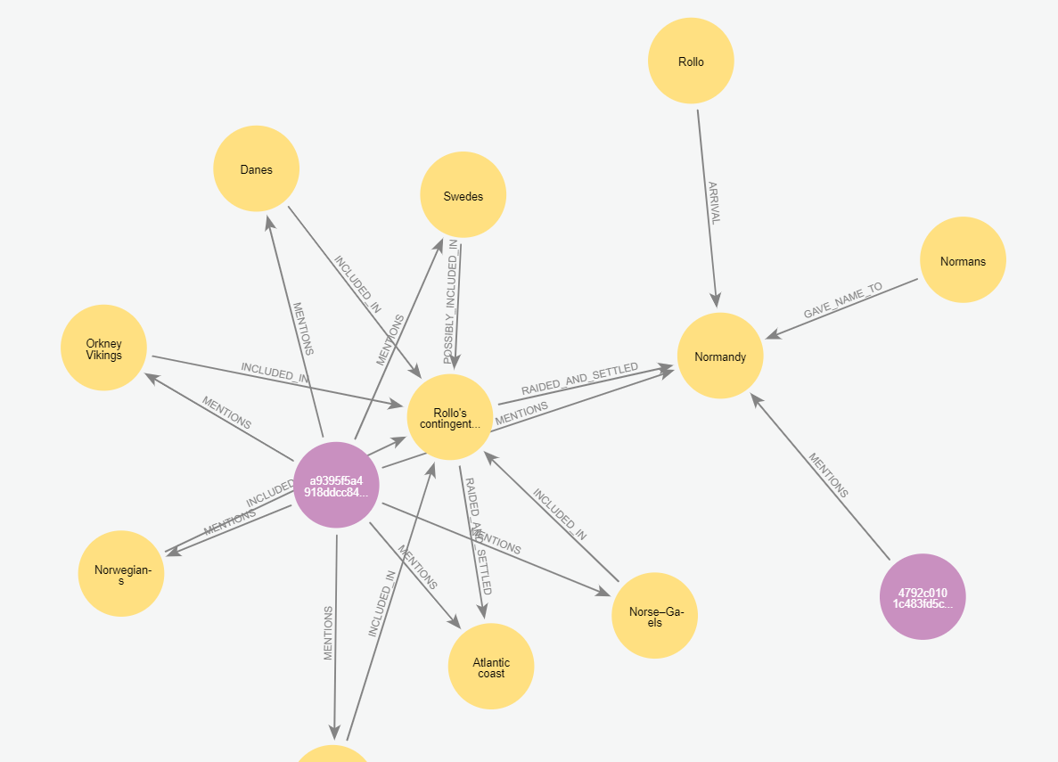
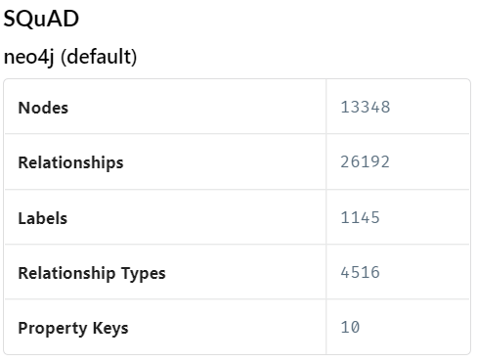

Slide 11
Approach 1
Structured retrieval:
extract entities from query
match entities to nodes in the knowledge graph
traverse relationships to retrieve documents connected to these entities
Unstructured retrieval: use vector similarity to retrieve additional documents that might not be directly connected to the entities.
Integration: Combine results, prioritizing structured retrieval over unstructured.
Recall: 69% - below expectations
Retrieved documents contained mentions but not the most relevant information.

Slide 12
Approach 2
Goal: Focus on semantic relationships rather than merely retrieving documents mentioning the query’s entities.
Relationship retrieval: Traverse the knowledge graph to extract relationships between entities relevant to the query.
Unstructured retrieval: Use vector similarity to retrieve top-ranked documents based on query relevance
Integration: Combine retrieved relationships and vector-based documents into the final context.
Recall: 91%

Slide 13
Approach 3
Goal: Hybrid retrieval with full-text search
Embedding-based retrieval: Convert the query into embeddings and perform a similarity search using the Neo4j vector index.
Full-text search: Use full-text indexing in the knowledge graph to retrieve nodes that match the query text.
Integration: Normalize scores from both retrieval methods. → Rank results by relevance and select the top three. → Add related semantic relationships from the graph to enrich the final context.
Recall: 93%

Slide 14
Summary
 | Recall | Answer accuracy
Baseline | 85% | 77%
Approach 1 | 69% | 74%
Approach 2 | 91% | 80%
Approach 3 | 93% | 83%

Slide 15
THANK YOU FOR YOUR
ATTENTION!

