Slide 1
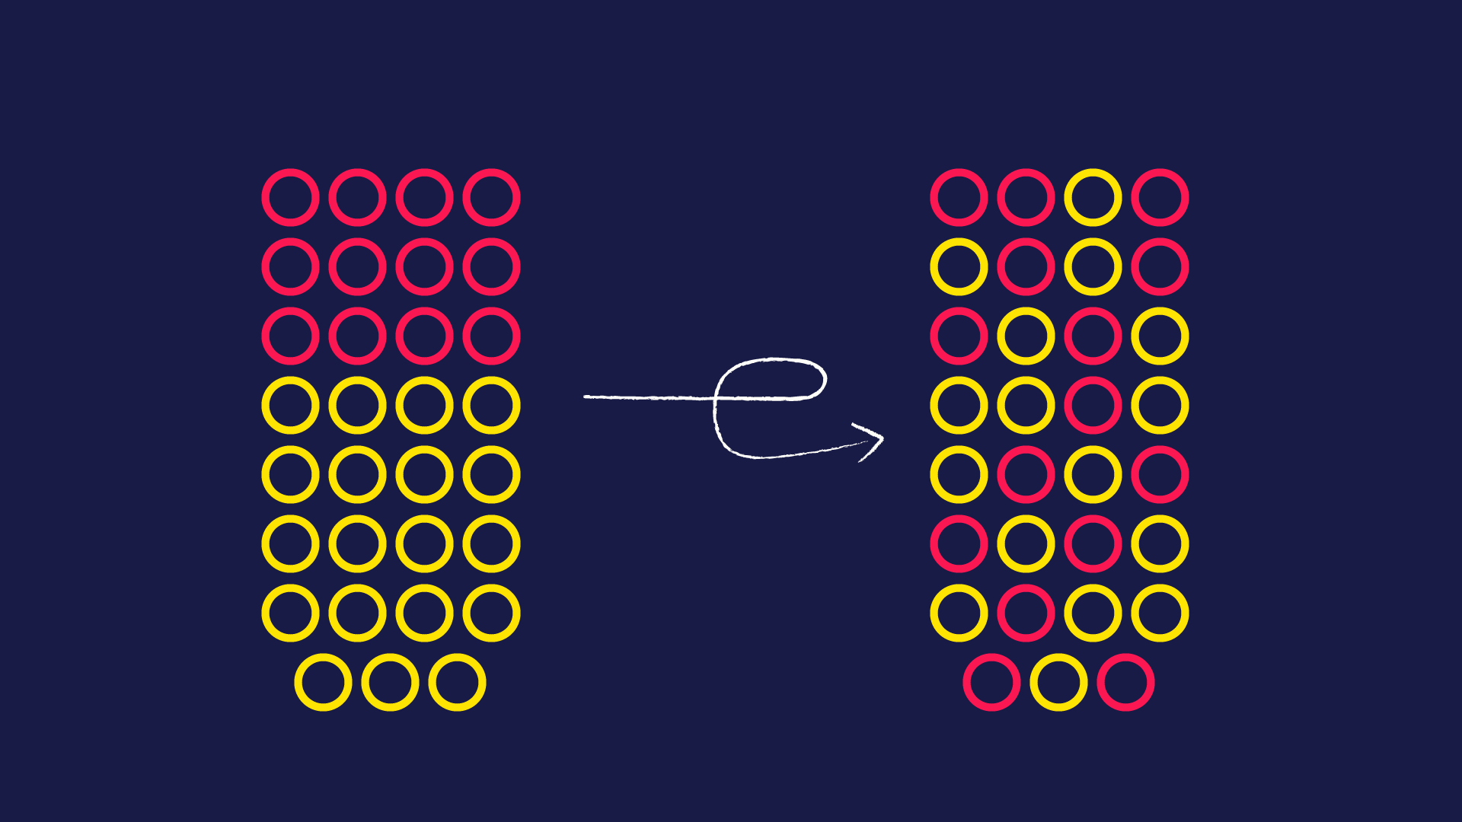
high entropy projections in machine learning
Emma Lukács
Supervisor: Adrián Csiszárik
Eötvös Loránd University
2025. 01. 09.

Slide 2
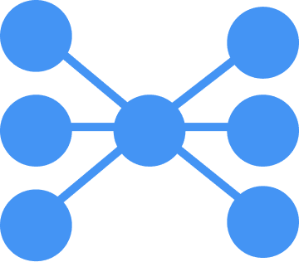
Structure of the presentation
Introduction of the topic
Progress of previous semesters
The MaxEnt-PCA approach
Experiments with Autoencoders
Conclusion and Future Steps

Slide 3
Summary of topic, progress so far

Slide 4
Introduction to Information Entropy
Information entropy, quantifies the uncertainty or average surprise associated with the outcomes of a random variable or a probability distribution. It measures the amount of information contained in a random variable or the average amount of surprise inherent in the possible outcomes of a system..
Information entropy in Machine Learning
Self-supervised Learning
In self-supervised learning, models are trained using pretext tasks where the data itself provides supervisory signals. Entropy maximization is employed as a principle to design these pretext tasks.
Anomaly Detection
Entropy-based anomaly detection methods utilize deviations from expected entropy levels to detect anomalies in data.
Active Learning – Query Strategies
In active learning scenarios, where the model selects the most informative samples to label, information entropy is used as a measure of uncertainty. Neural networks estimate the entropy of predictions to determine which data points would benefit the most from being labeled
Introduction
Previous progress
New framework
MaxEnt-PCA
Experiments
Future steps

Slide 5
Maximum Entropy Projection
Maximum Sliced Entropy (MSE) is instrumental in capturing the most informative features of high-dimensional data. MSE, by projecting the data onto lower-dimensional subspaces, aims to maximize the entropy across various data slices
Tsur et al. (2023)
Given a random variable X with in $ℝ^{d}$ the k-dimensional Maximum Sliced Entropy (MSE) of X, denoted as $sh_{k}(X)$, is defined by
where where $St(k,d)$ represents the Stiefel manifold of all d × k matrices with orthonormal columns, and $h$ denotes the differential entropy
Introduction
Previous progress
New framework
MaxEnt-PCA
Experiments
Future steps

Slide 6
Principal Component Analysis
Methodology
Principal Component Analysis (PCA) is a statistical technique that employs an orthogonal transformation to convert a set of correlated variables into a series of linearly uncorrelated variables known as principal components. This method is effective when the data is normally distributed, as PCA identifies the axes (principal components) that maximize the variance in the data,
Let X ∼ N(m,Σ) with m = 0 and Σ ∈ $ℝ^{dxd}$ being full-rank. The equivalence between the MSE and PCA is established under the assumption that the k-dimensional PCA for Σ is given by the optimization problem:
where $A_{PCA}$ is the matrix that contains the first k eigenvectors of Σ, which correspond to its largest k eigenvalues.
Introduction
Previous progress
New framework
MaxEnt-PCA
Experiments
Future steps

Slide 7
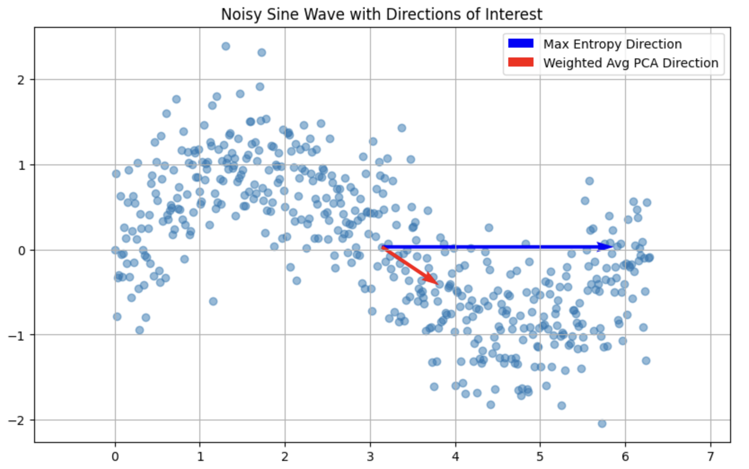
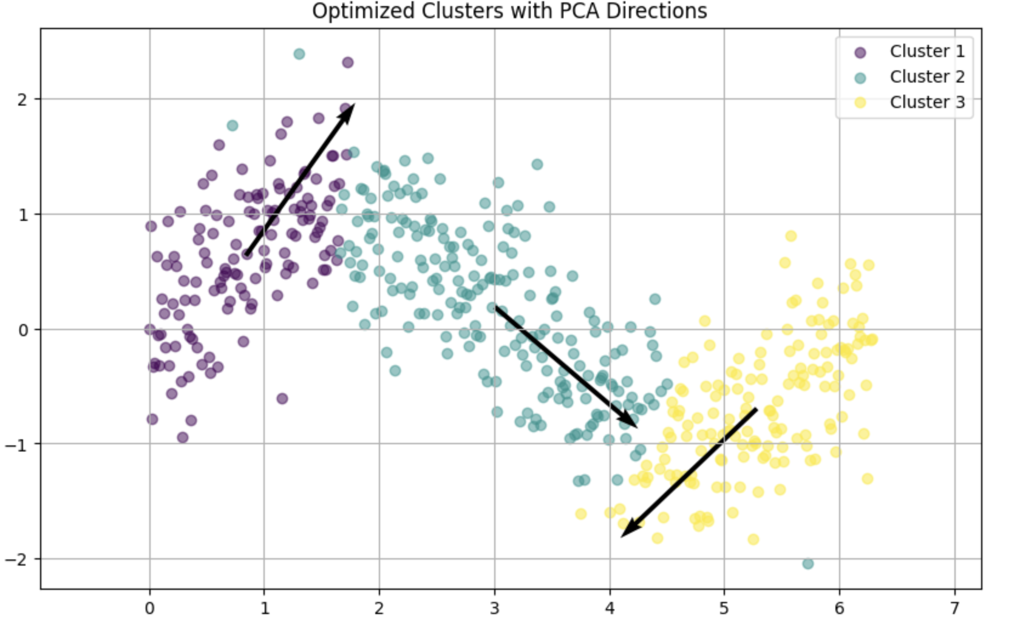
A New Approach I.
Heuristically find the Maximum Entropy projection by iterating over 0-360 degrees
Find the globally optimal PCA first component
Cluster the data and find the first component of each cluster
Use some basic (entropy based) weighing method to find the resultant vector
Introduction
Previous progress
New framework
MaxEnt-PCA
Experiments
Future steps

Slide 8
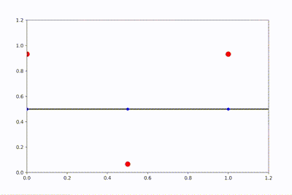
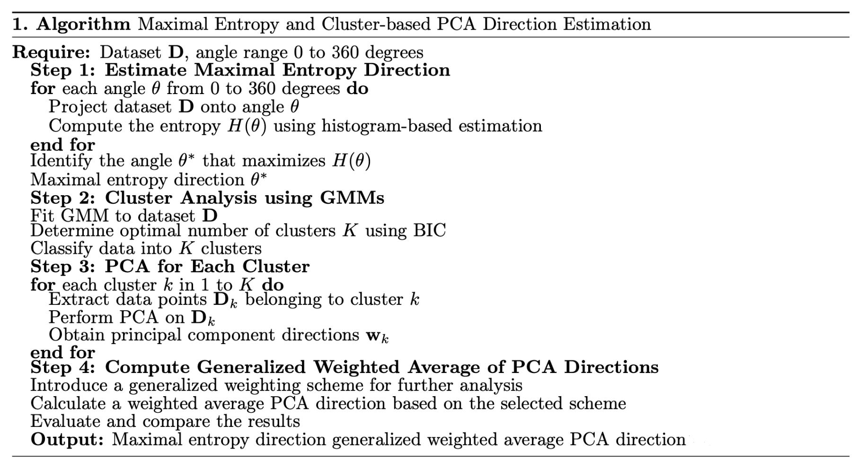
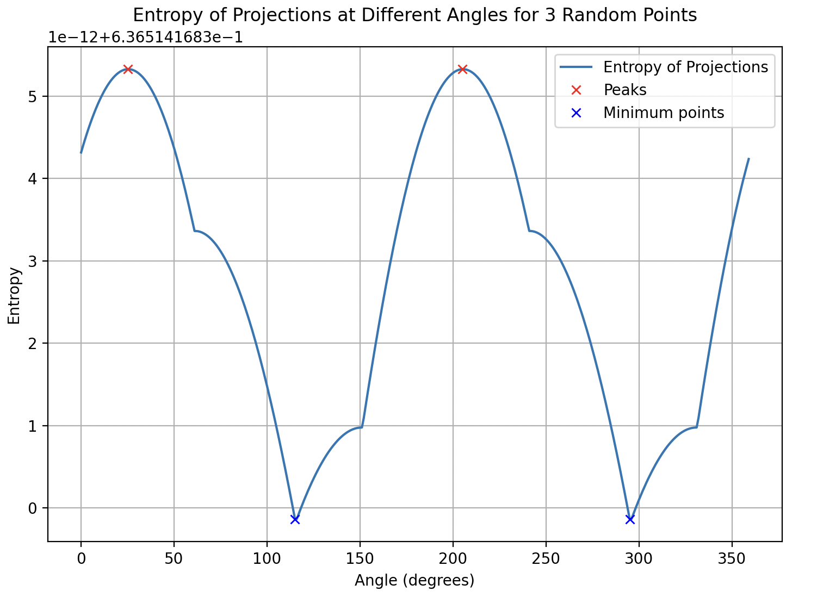
A New Approach II.
Introduction
Previous progress
New framework
MaxEnt-PCA
Experiments
Future steps

Slide 9
Questions for the semester
K1
How can we algorithmically determine a maximum entropy subspace of high-dimensional data?
K2
How can we utilize it in different scenarios compared to standard variance-based methods?
Introduction
Previous progress
New framework
MaxEnt-PCA
Experiments
Future steps

Slide 10
MAXEnt-pca

Slide 11
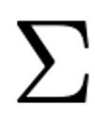
Graph embedding
Intrinsic graph: ,
The graph embedding of the graph G is defined as an algorithm to find the desired low-dimensional representations with relationships among the vertices of G that best characterize the similarity relationship between the vertex pairs in G.
Similarity characteristics that are to be suppressed in the dimension-reduced feature space
PCA follows the linearization of graph embedding with the intrinsic graph connecting all the data pairs with equal weights and constrained by scale normalization on the projection vector.
Introduction
Previous progress
New framework
MaxEnt-PCA
Experiments
Future steps

Slide 12
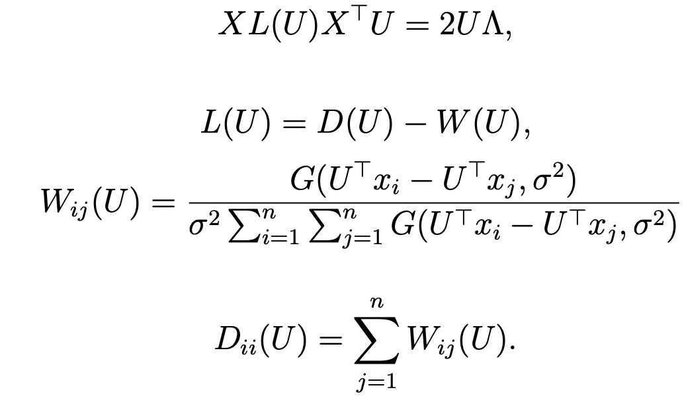
The MaxEnt-PCA algorithm
He et al. (2010)
Observation
By setting the parameter to a high enough value, in the Gaussian setting, the result of MaxEnt-PCA coincides with the result of PCA
Introduction
Previous progress
New framework
MaxEnt-PCA
Experiments
Future steps

Slide 13
The MaxEnt-PCA algorithm – Observations
2D bimodal Gaussian distribution
The MaxEnt-PCA empirically converges to the PCA projection as the bandwidth parameter increases
Introduction
Previous progress
New framework
MaxEnt-PCA
Experiments
Future steps

Slide 14
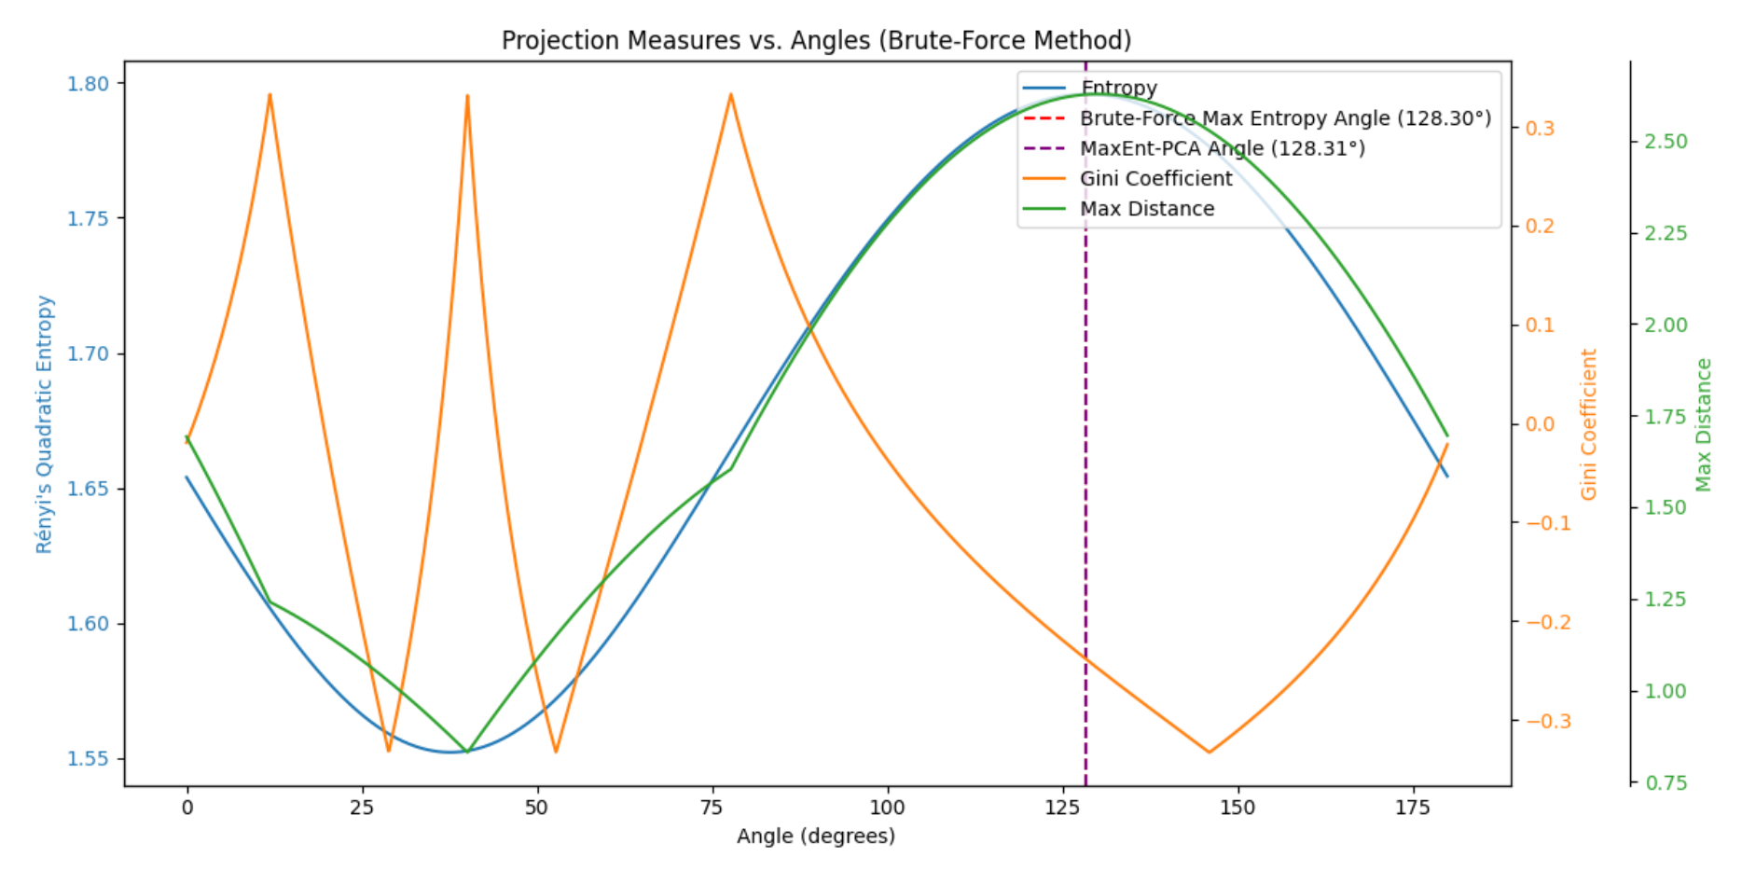
The MaxEnt-PCA algorithm – Observations
Maximum entropy projection almost perfectly coincides with the angle that maximizes the separation between the two furthest points
The low Gini coefficient represents a more uniform distance distribution
Introduction
Previous progress
New framework
MaxEnt-PCA
Experiments
Future steps

Slide 15
Experiments

Slide 16
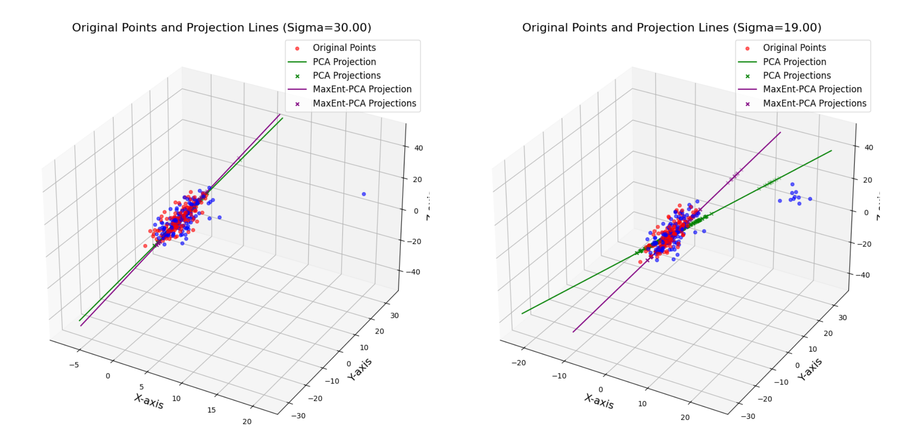
Experiments with Anomaly Detection
Synthetic datasets where data points were sampled from a multivariate Gaussian distribution with randomly selected means and covariances.
Anomaly Detection process
PCA
MaxEnt-PCA
Introduction
Previous progress
New framework
MaxEnt-PCA
Experiments
Future steps

Slide 17
Summary and Conclusions
The MaxEnt-PCA based on tbe graph embedding perspective of dimensionality reduction proved successful.
K1
How can we algorithmically determine a maximum entropy subspace of high-dimensional data?
In certain anomaly detection scenarios, the MaxEnt-PCA, via its robustness, outperformed the PCA according to each applied measure.
K2
How can we utilize it in different scenarios compared to standard variance-based methods?
Introduction
Previous progress
New framework
MaxEnt-PCA
Experiments
Future steps

Slide 18
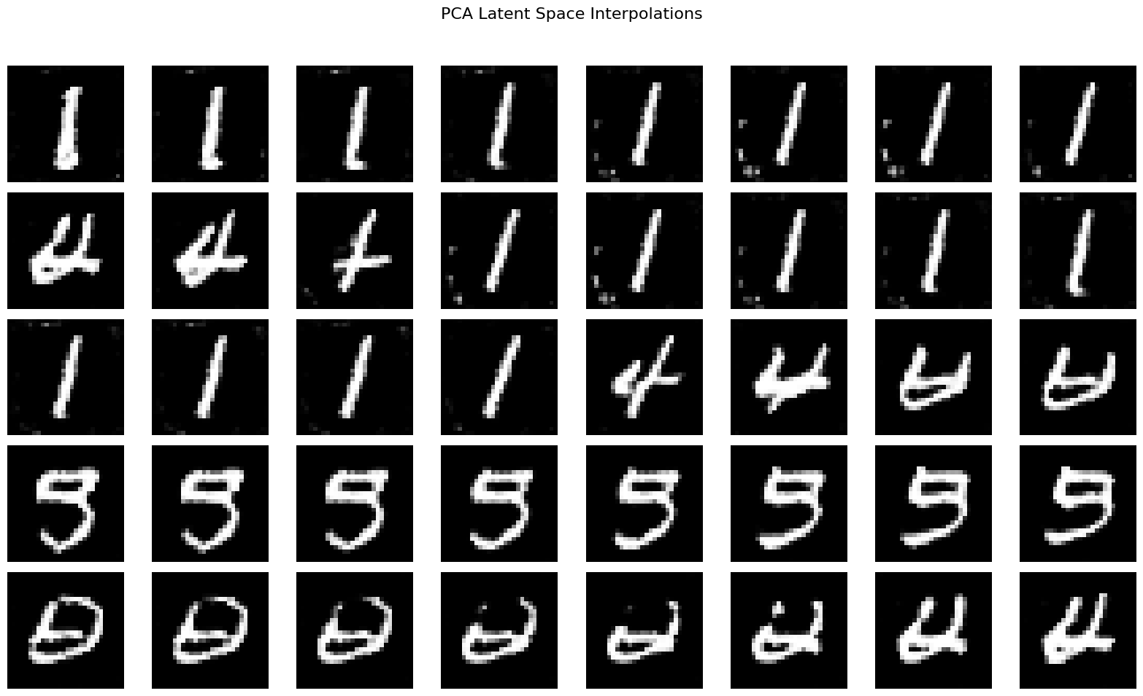
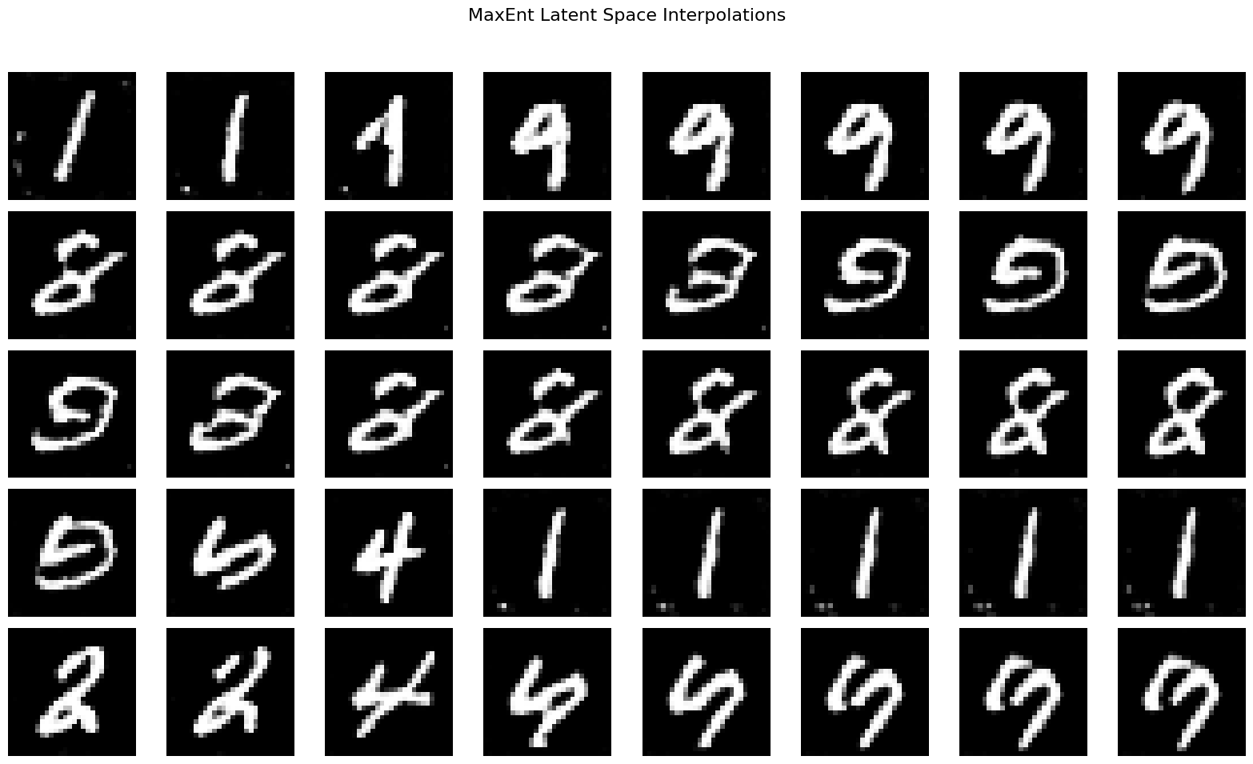
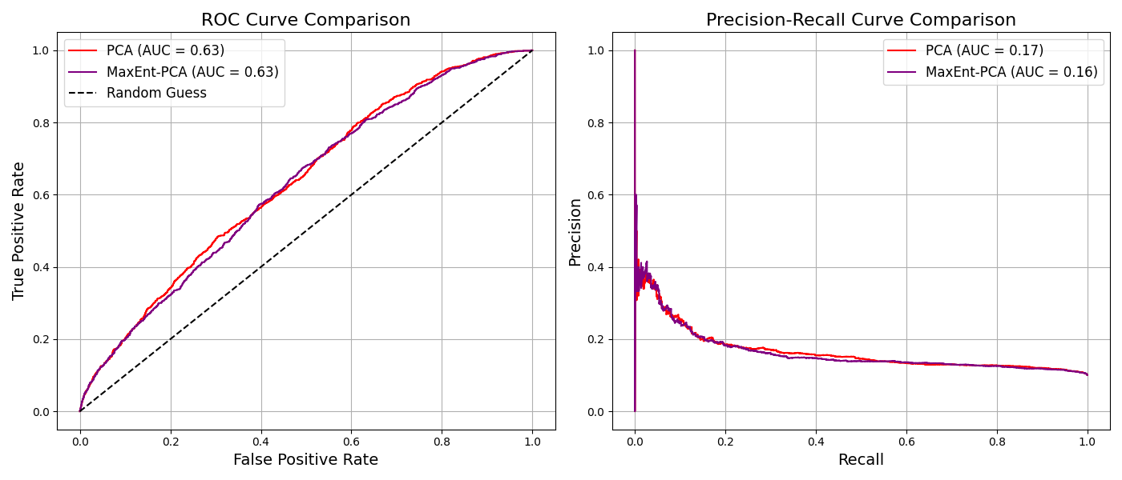
Other scenarios – Future steps
Introduction
Previous progress
New framework
MaxEnt-PCA
Experiments
Future steps

Slide 19
Thank you for the attention!

Slide 20
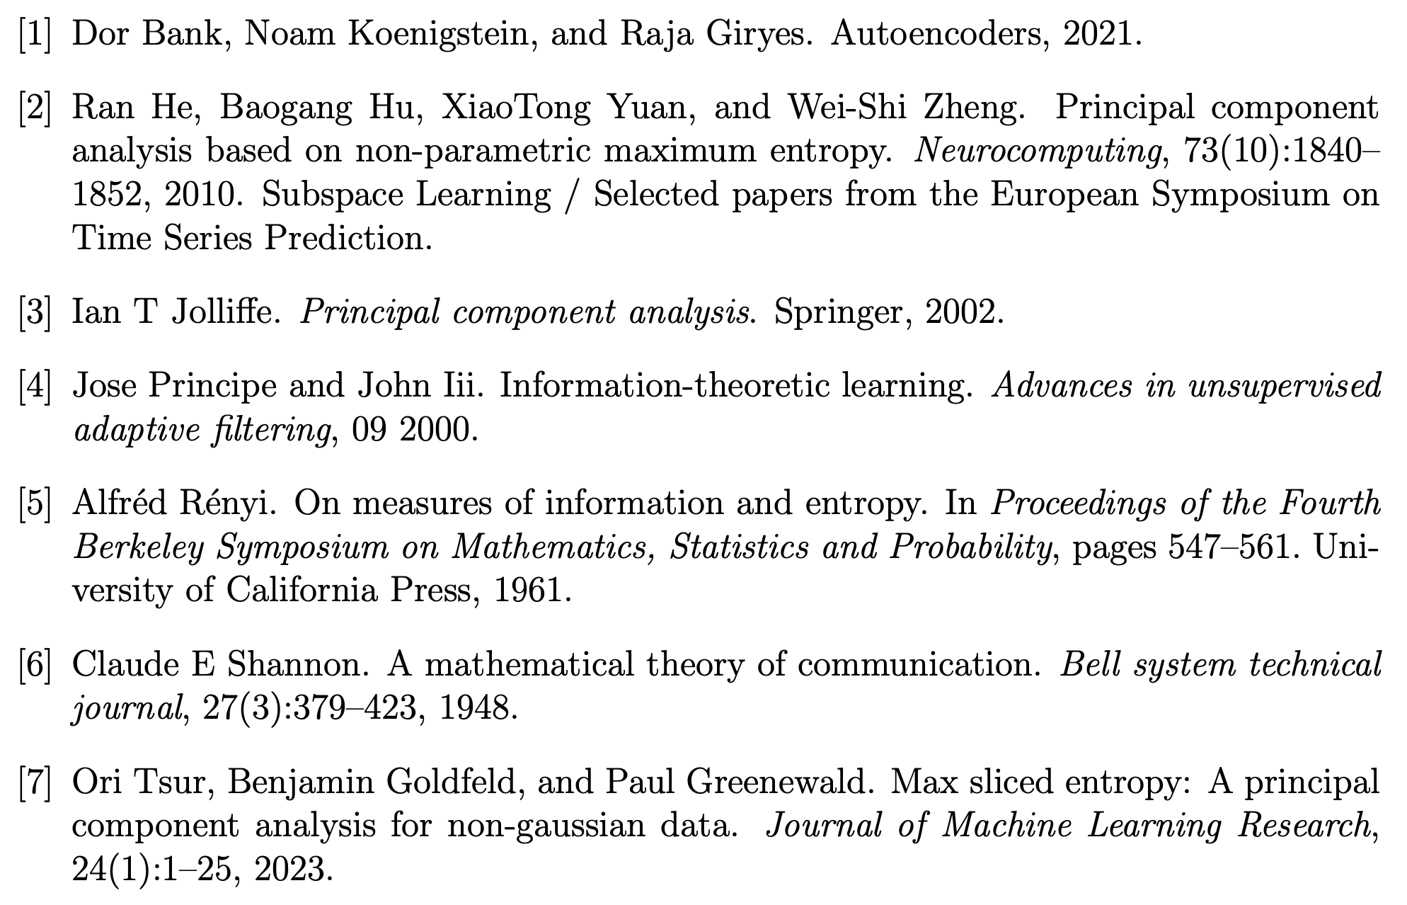
Bibliography
Attachment

