Slide 1
Impact of Noise on
RAG Models for
Question Answering
Adrienn Molnár
Supervisor: Adrián Csiszárik
Eötvös Loránd University
2024.05.30.

Slide 2
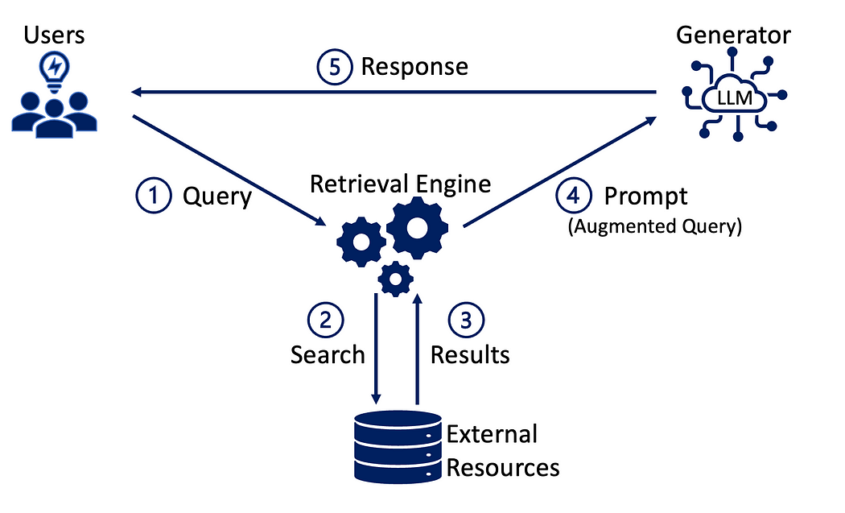
RAG Model

Slide 3
Goal of the Project
Test the performance of the RAG model with noisy data.
Noise: simulating OCR (optical character recognition) errors
Example: old documents, historical records -> not digitalized
text recognition software, but it often introduces mistakes
Question: how OCR-induced noise affects the retrieval of relevant documents?

Slide 4
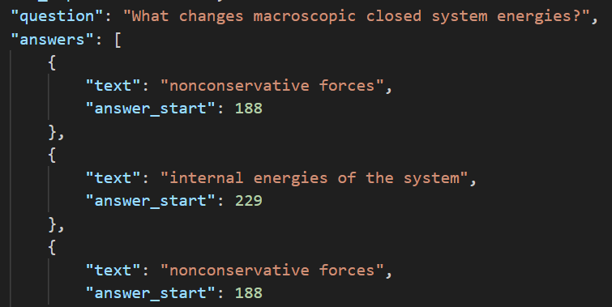
SQuAD Database
Stanford Question Answering Dataset
Wikipedia articles

Slide 5
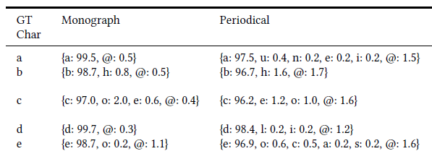
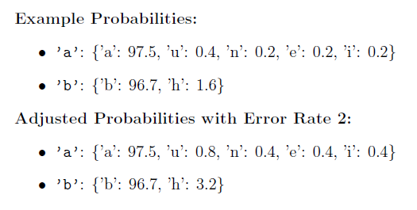
Optical Character Recognition
Error rate: control the frequency of errors

Slide 6
Model specifications
Model: GPT-3.5 Turbo
Metric for retrieval: Recall
Answer evaluation: exact match, fuzzy match (comparing entities, allowing minor differences in wording)
Initial run: model successfully retrieved correct context (202 out of 263)
Category | Count | Percentage
Correct Answer, Correct Context | 169 | 71%
Correct Answer, Incorrect Context | 14 | 6%
Correct Context, Incorrect Answer | 33 | 14%
Both Incorrect | 21 | 9%

Slide 7
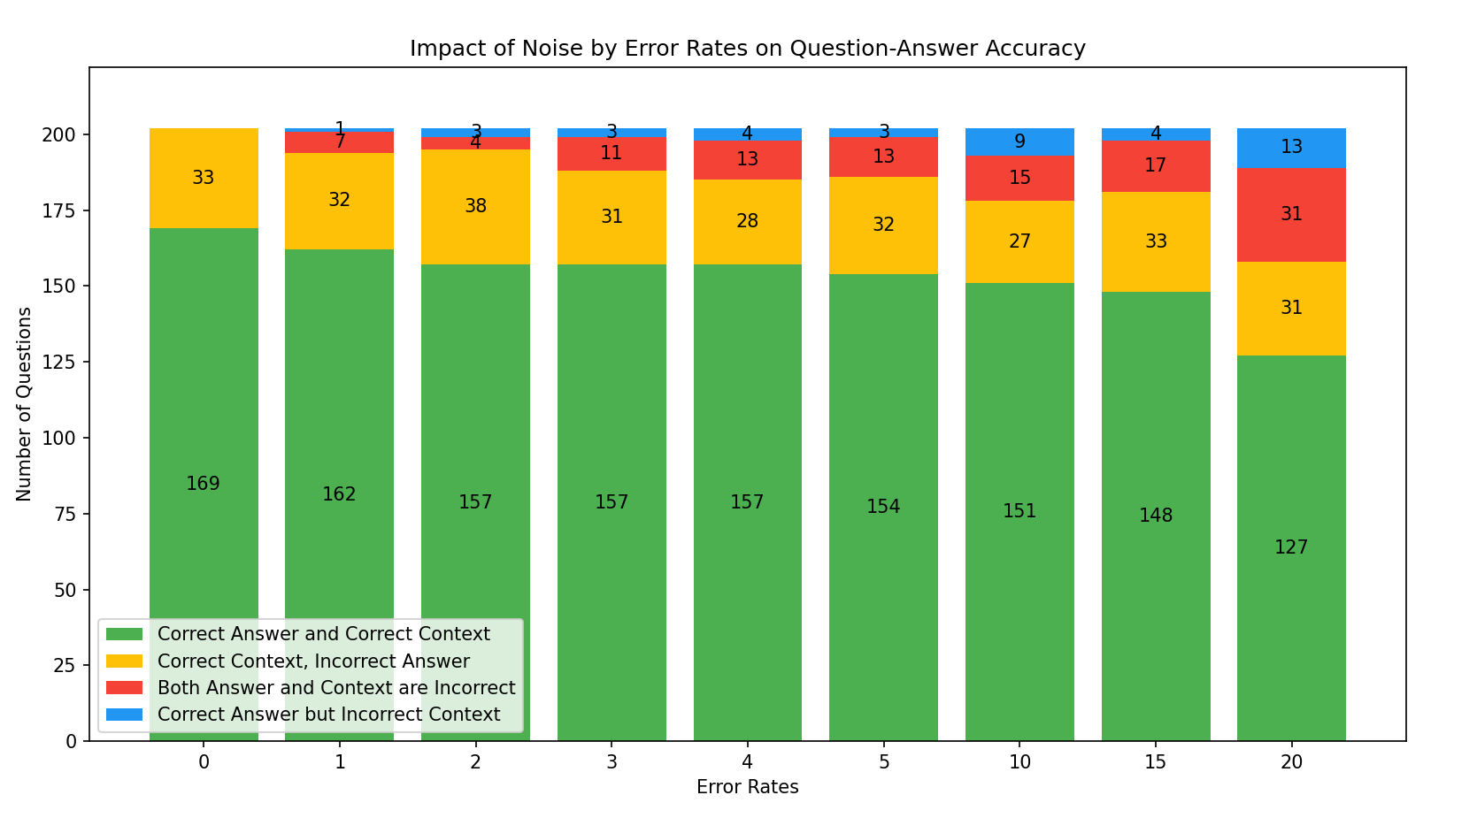

Slide 8
CONCLUSIONS
The model does not find the correct context:
„The context provided does not mention…”
„It is not specified in the context provided”
In some cases, the model can provide a correct answer without the correct context.
Number of wrong answer, right context remains almost the same: almost the same question are answered wrong compared to the initial run

Slide 9
Vector Embedding Analysis
PCA: the first component captures approximately 4.60% of the total variance, while the second component captures about 3.17%
Mean deviation
Goal: reversing noise by altering the vector embeddings
Results: From error rates 1 to 11, the vectors exhibit a consistent directional shift. The magnitude of this shift increases proportionally with the error rate.

Slide 10
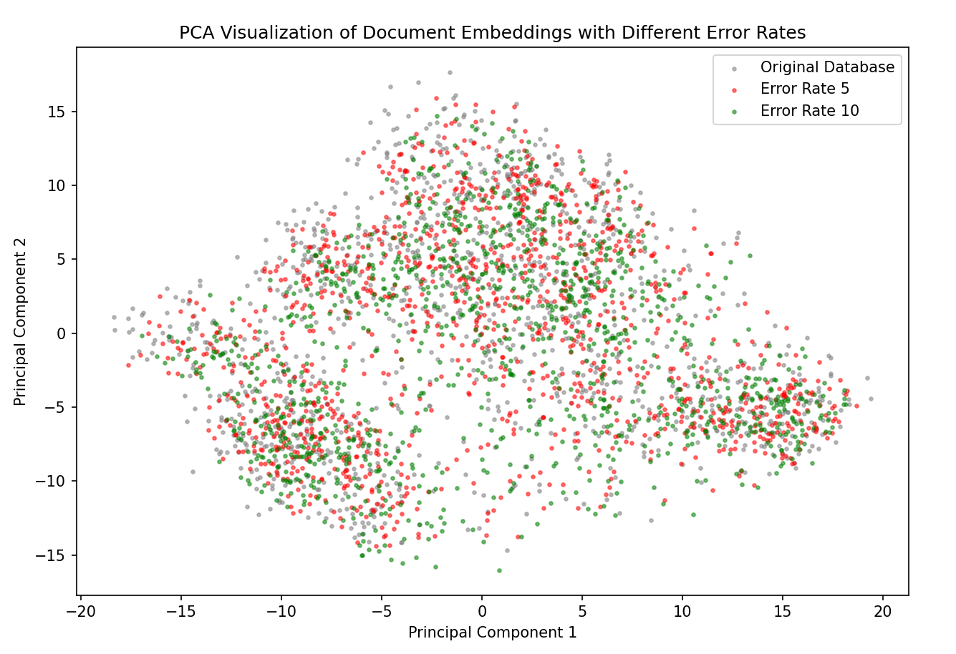

Slide 11
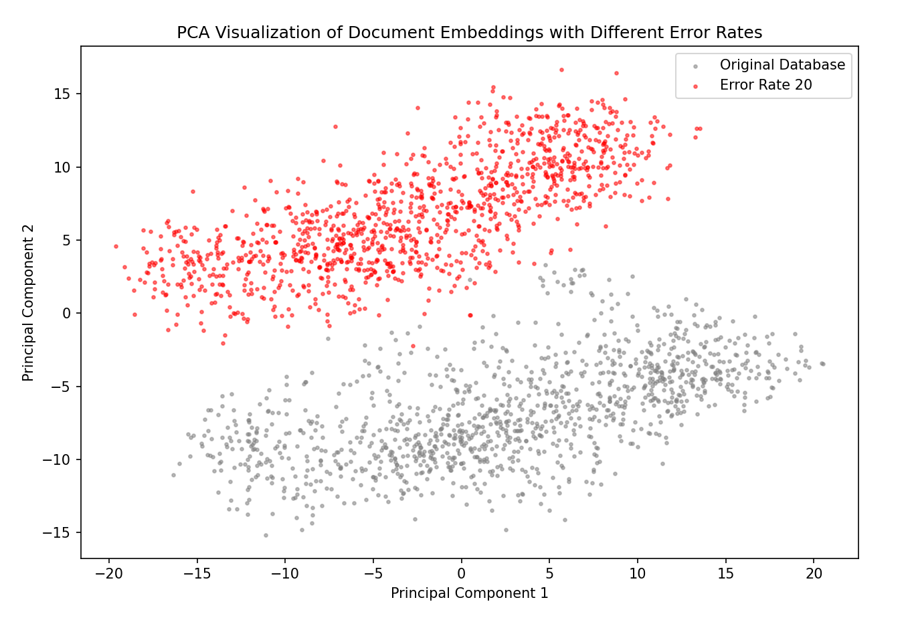

Slide 12
Results
For the first principal component, the mean deviation gradually increased with noise up to the 11th error rate.
At the 12th error rate, there was a significant shift: the mean deviation turned negative and continued to increase in the negative direction as the error rate increased.
Second principal component:as the error rate increased, the mean deviation initially moved further into the negative direction until the 13th error rate.
After this point, there were sudden jumps from a negative to positive deviation, while the magnitude of the deviation continued to increase

Slide 13
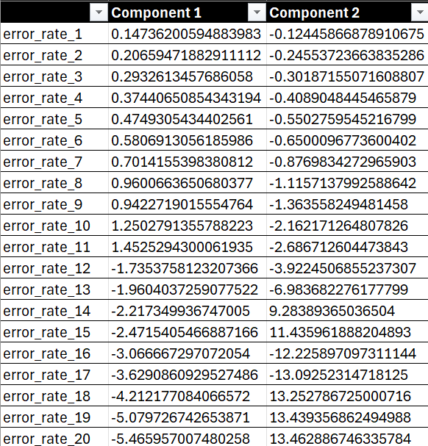

Slide 14
THANK YOU FOR YOUR
ATTENTION!

