Slide 1
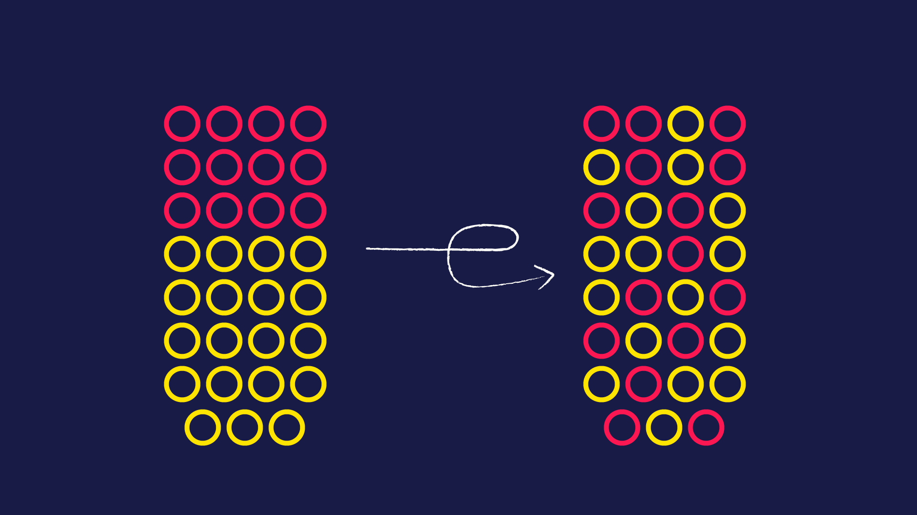
Entropy estimation and high entropy projections
Emma Lukács
Supervisor: Adrián Csiszárik
Eötvös Loránd University
2024. 05. 30.

Slide 2
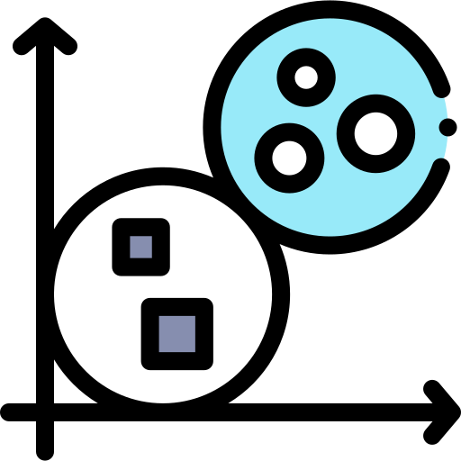
Structure of the presentation
Introduction of the topic, main research focus
PCA and Kozachenko-Leonenko approach
Experiments with Autoencoders
Experiments with Clustering
A New Approach
Conclusion and Future Steps

Slide 3
Introduction
K1
What can we say about the high level distinctions about different approaches in estimating the Maximum Entropy Projection?
K2
How can we utilize these observations to implement a new approach?
Research questions
Introduction
Estimators
Experiments
Conclusion
Future steps

Slide 4
Introduction to Information Entropy
Information entropy, quantifies the uncertainty or average surprise associated with the outcomes of a random variable or a probability distribution. It measures the amount of information contained in a random variable or the average amount of surprise inherent in the possible outcomes of a system..
Information entropy in Machine Learning
Self-supervised Learning
In self-supervised learning, models are trained using pretext tasks where the data itself provides supervisory signals. Entropy maximization is employed as a principle to design these pretext tasks.
Anomaly Detection
Entropy-based anomaly detection methods utilize deviations from expected entropy levels to detect anomalies in data.
Active Learning – Query Strategies
In active learning scenarios, where the model selects the most informative samples to label, information entropy is used as a measure of uncertainty. Neural networks estimate the entropy of predictions to determine which data points would benefit the most from being labeled
Research questions
Introduction
Estimator
Experiments
Conclusion
Future steps

Slide 5
Maximum Entropy Projection
Maximum Sliced Entropy (MSE) is instrumental in capturing the most informative features of high-dimensional data. MSE, by projecting the data onto lower-dimensional subspaces, aims to maximize the entropy across various data slices
Given a random variable X with in $ℝ^{d}$ the k-dimensional Maximum Sliced Entropy (MSE) of X, denoted as $sh_{k}(X)$, is defined by
where where $St(k,d)$ represents the Stiefel manifold of all d × k matrices with orthonormal columns, and $h$ denotes the differential entropy
Research questions
Introduction
Estimators
Experimets
Conclusion
Future steps

Slide 6
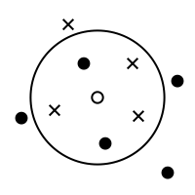
The Kozachenko-Leonenko Estimator
Methodology
The Kozachenko-Leonenko (KL) estimator is a non-parametric method used to estimate the entropy of a probability distribution based solely on observed data points without assuming any specific underlying probability density function.
The main assumption of the KL estimation is that the density is constant within the unit ball approximated by
Research questions
Introduction
Estimators
Experiments
Conclusion
Future steps

Slide 7
Principal Component Analysis
Methodology
Principal Component Analysis (PCA) is a statistical technique that employs an orthogonal transformation to convert a set of correlated variables into a series of linearly uncorrelated variables known as principal components. This method is effective when the data is normally distributed, as PCA identifies the axes (principal components) that maximize the variance in the data,
Let X ∼ N(m,Σ) with m = 0 and Σ ∈ $ℝ^{dxd}$ being full-rank. The equivalence between the MSE and PCA is established under the assumption that the k-dimensional PCA for Σ is given by the optimization problem:
where $A_{PCA}$ is the matrix that contains the first k eigenvectors of Σ, which correspond to its largest k eigenvalues.
Research questions
Introduction
Estimators
Experiments
Conclusion
Future steps

Slide 8
Experiments

Slide 9
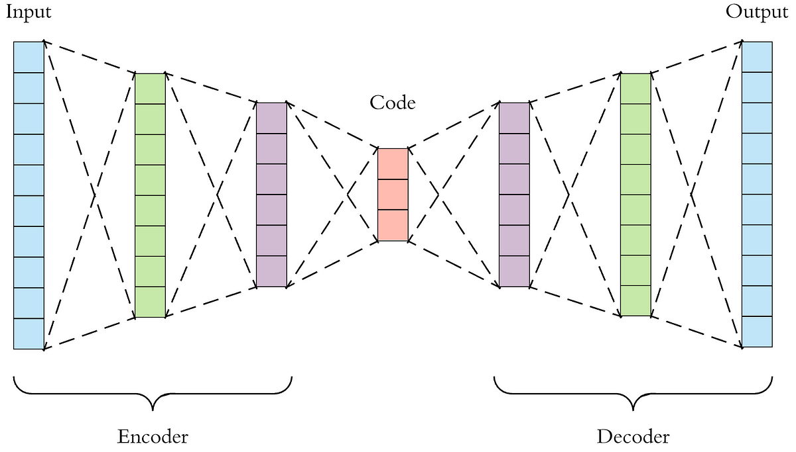
Dimensionality Reduction and Entropy Estimation Analysis
Source: https://towardsdatascience.com/applied-deep-learning-part-3-autoencoders-1c083af4d798
Linear Autoencoder
Nonlinear Autoencoder
features a simpler architecture, utilizing a single linear layer for both encoding and decoding
comprises multiple hidden layers, structured with a configuration of 300-200-100–hidden units.
employs a combination of linear and Rectified Linear Unit (ReLU) activation functions within the hidden layers
The primary goal is to preserve essential information while reducing dimensionality, enabling a more manageable representation of the dataset. By employing autoencoders, I aimed to create lower-dimensional representations that maintain significant data characteristics.
Data generation
One strategy generates multidimensional data with a normal distribution, emphasizing data concentration around a hyperplane by scaling specific dimensions. The other strategy creates datasets with decorrelated Gaussian data using Cholesky decomposition on predefined covariance matrices.
Research questions
Introduction
Estimator
Experiments
Conclusion
Future steps

Slide 10
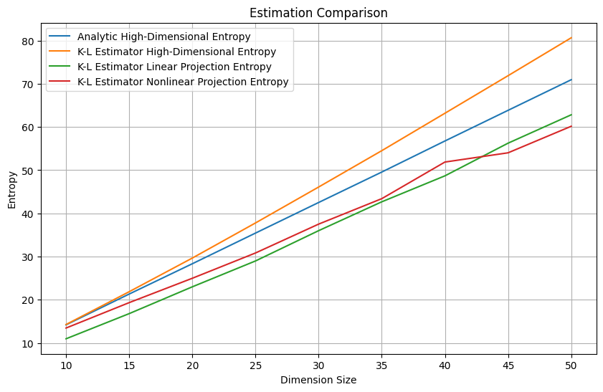
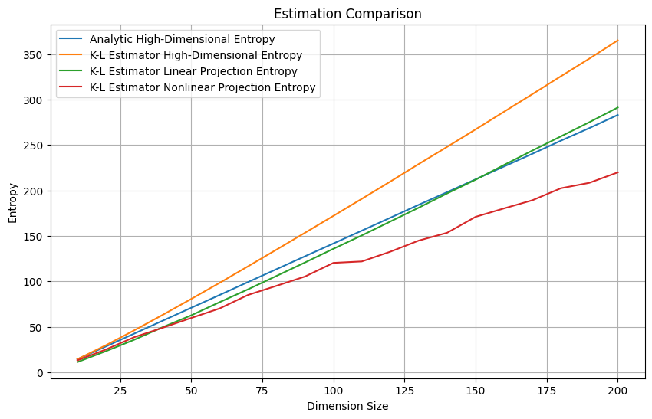
Analysis Results
Linear autoencoder's projections, similar to PCA results, closely matched analytical values, especially in dimensions over 60.
Highlights effectiveness of variance-based methods for handling Gaussian-like data.
Linear autoencoders can produce projections comparable to PCA and enhance entropy estimation.
Encourages further exploration into the relationship between projection techniques and complex data scenarios.
Research questions
Introduction
Estimator
Experiments
Conclusion
Future steps

Slide 11
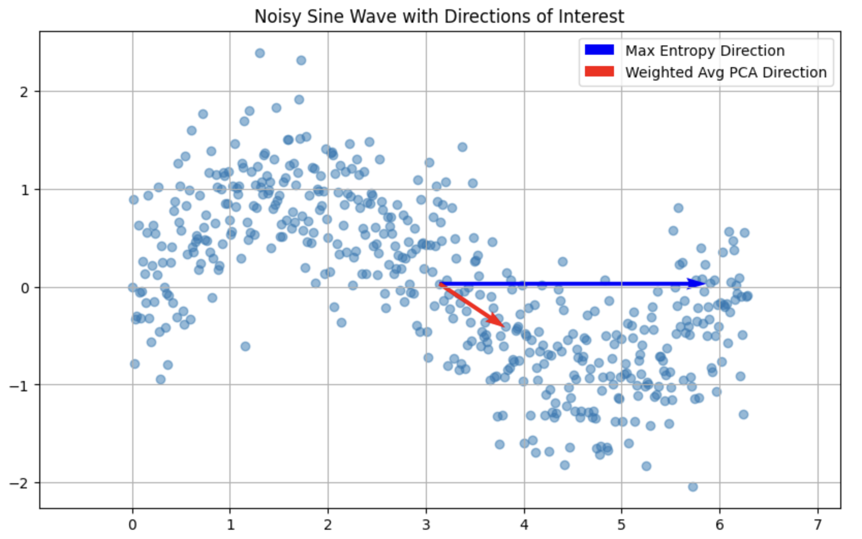
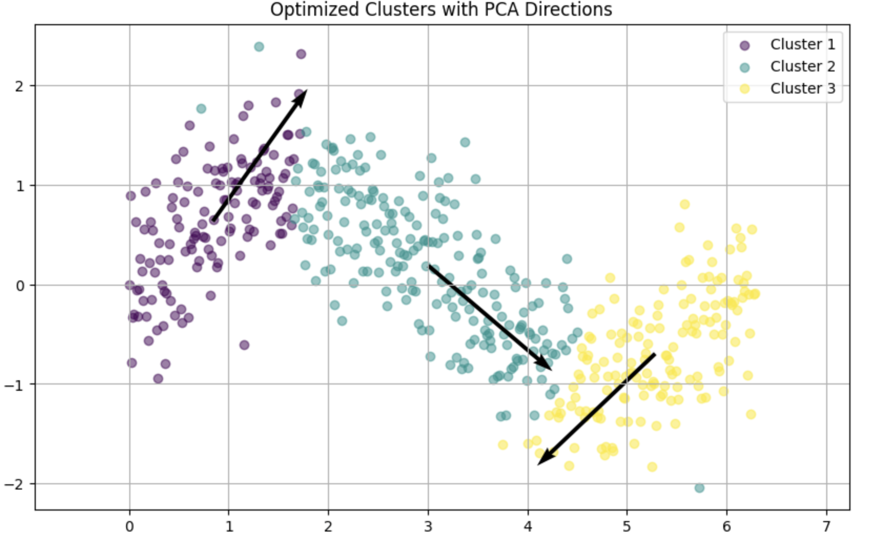
A New Approach I.
Heuristically find the Maximum Entropy projection by iterating over 0-360 degrees
Find the globally optimal PCA first component
Cluster the data and find the first component of each cluster
Use some basic (entropy based) weighing method to find the resultant vector
Research questions
Introduction
Estimator
Experiments
Conclusion
Future steps

Slide 12
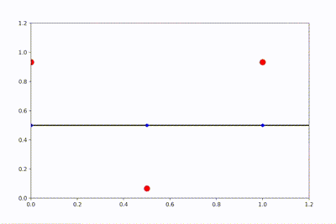
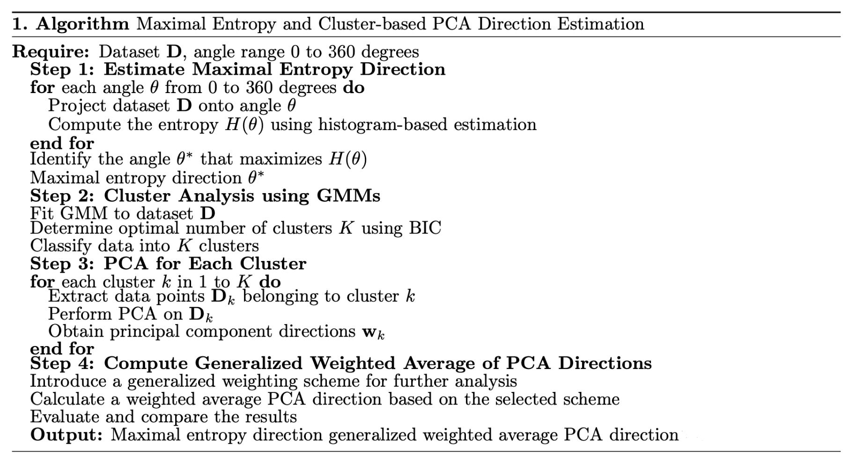
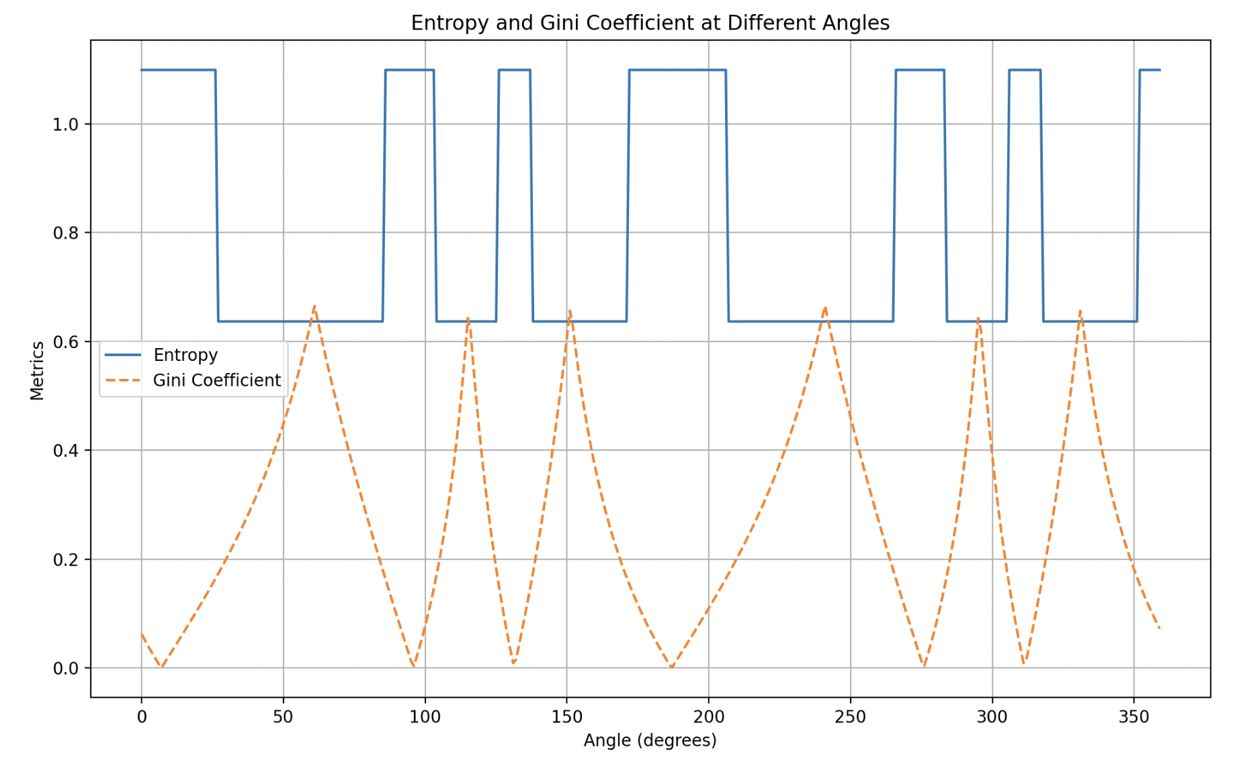
A New Approach II.
Research questions
Introduction
Estimators
Experiments
Conclusion
Future steps

Slide 13
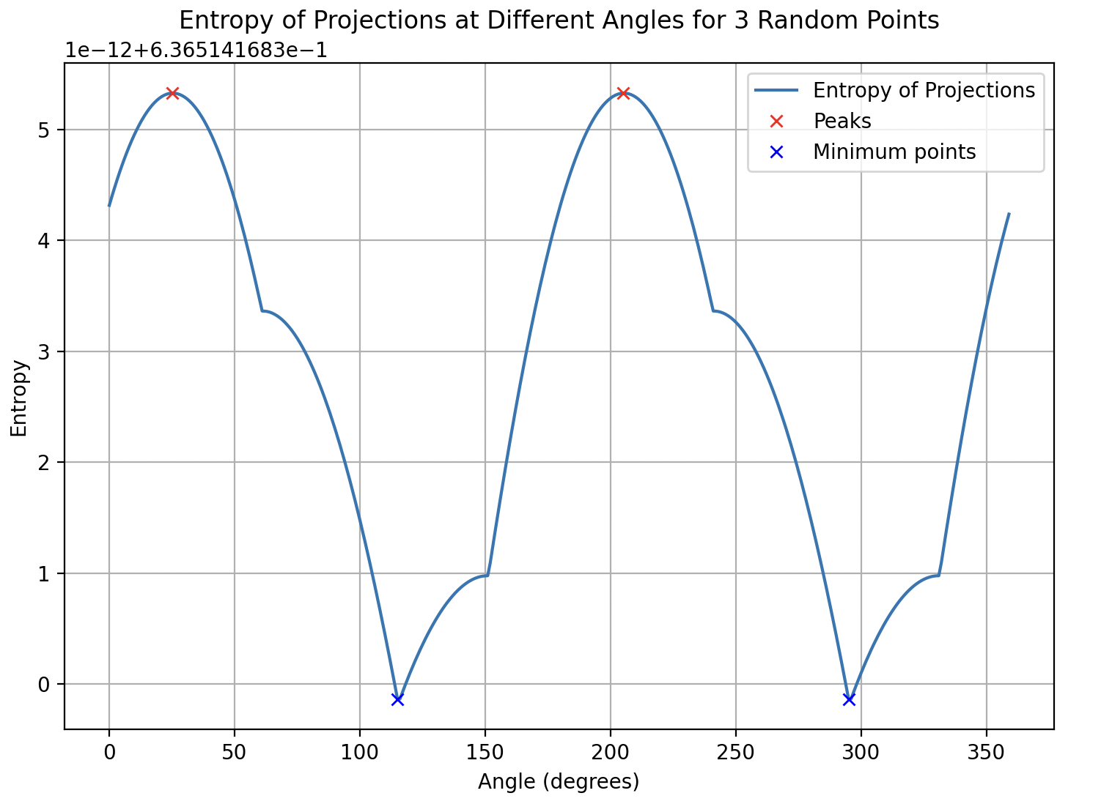
A New Approach II.
Research questions
Introduction
Estimators
Experiments
Conclusion
Future steps

Slide 14
Summary and Conclusions
PCA captures global variance, making it suitable for Gaussian-like data. It may miss local data variability. k-nearest neighbors approach captures local structure and variability, which is ideal for complex, non-Gaussian data but can be biased in higher dimensions
K1
What can we say about the high level distinctions about different approaches in estimating the Maximum Entropy Projection?
A new approach can combine PCA and KL approaches to leverage global structure and local variability. Using Gaussian Mixture Models (GMMs) to segment data improves Gaussian characteristics, aiding analysis. A component weighing system balances local and global properties, while transforming PCA vectors into a canonical form ensures consistency.
K2
How can we utilize these observations to implement a new approach?
Research questions
Introduction
Estimators
Experiments
Conclusion
Future steps

Slide 15
Future Steps
Further enhance the hybrid algorithm combining PCA, KL, and MSE approaches by experimenting with different weighing systems and optimization techniques to improve accuracy and efficiency in various data scenarios.
Investigate how the improved entropy estimation techniques can be integrated into existing machine learning models, particularly for feature selection and dimensionality reduction in high-dimensional data.
Research questions
Introduction
Estimators
Experimtens
Conclusion
Future steps

Slide 16
Thank you for the attention!

Slide 17
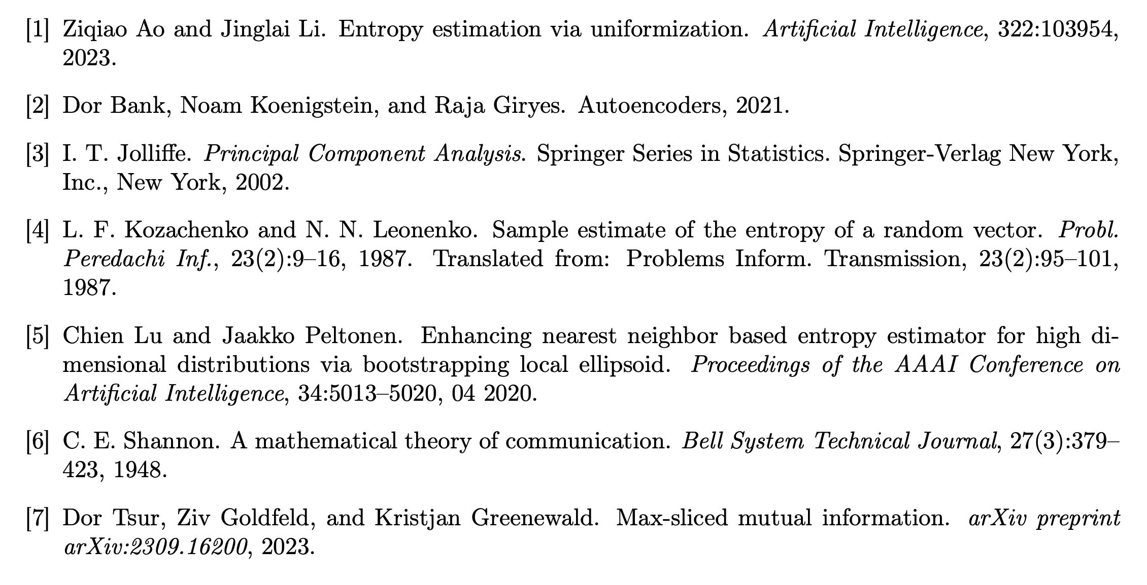
Bibliography
Attachment

