Slide 1
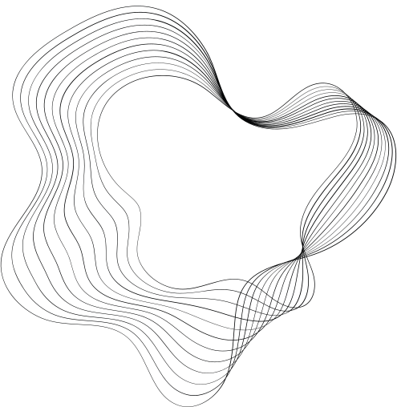

EXPANDING THE KNOWLEDGE OF DEEP NEURAL NETWORKS
Adrienn Molnár
Supervisor: Adrián Csiszárik
Eötvös Loránd University
2024.01.08.

Slide 2
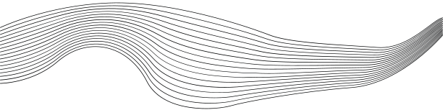
CONTENT
01
TRANSFORMER MODEL
02
FINE-TUNING
03
IN-CONTEXT LEARNING
04
RETRIEVAL-AUGMENTED MODELS
05
CONCLUSION, FUTURE WORK

Slide 3
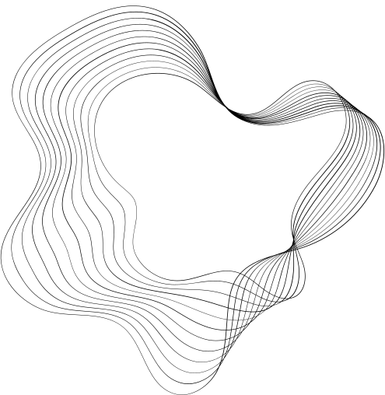
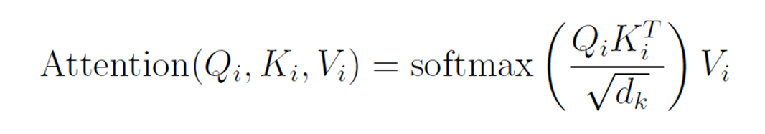
TRANSFORMER
  Tokenization: decompose input intosmaller units known as tokens
  Self-attention module:
    each input token is processed to generate three distinct matrices: Query(Q), Key (K), and Value (V )
    For a single token, this operation can be formalized as follows:

Slide 4
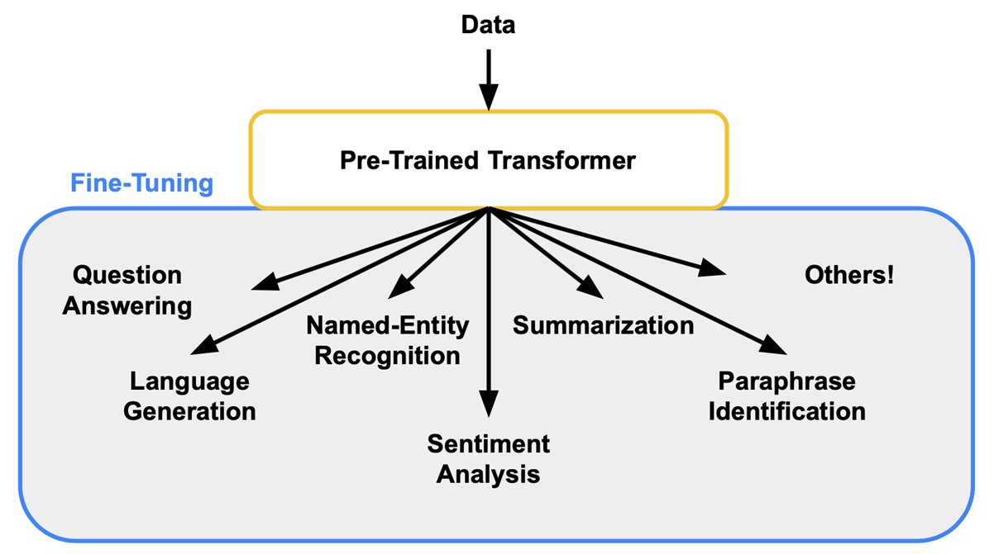
FINE-TUNING
TRANSFORMER MODELS
  adjusting the parameters of a pre-trained model for a specific task

Slide 5
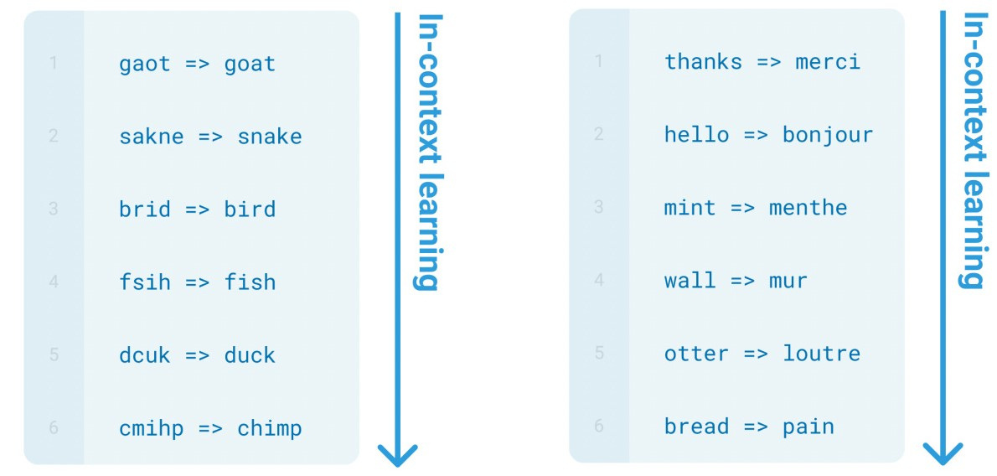
IN-CONTEXT LEARNING
  learn new tasks and skills simply from new examples in the input, without any gradient updates or changes to the pretrained model

Slide 6
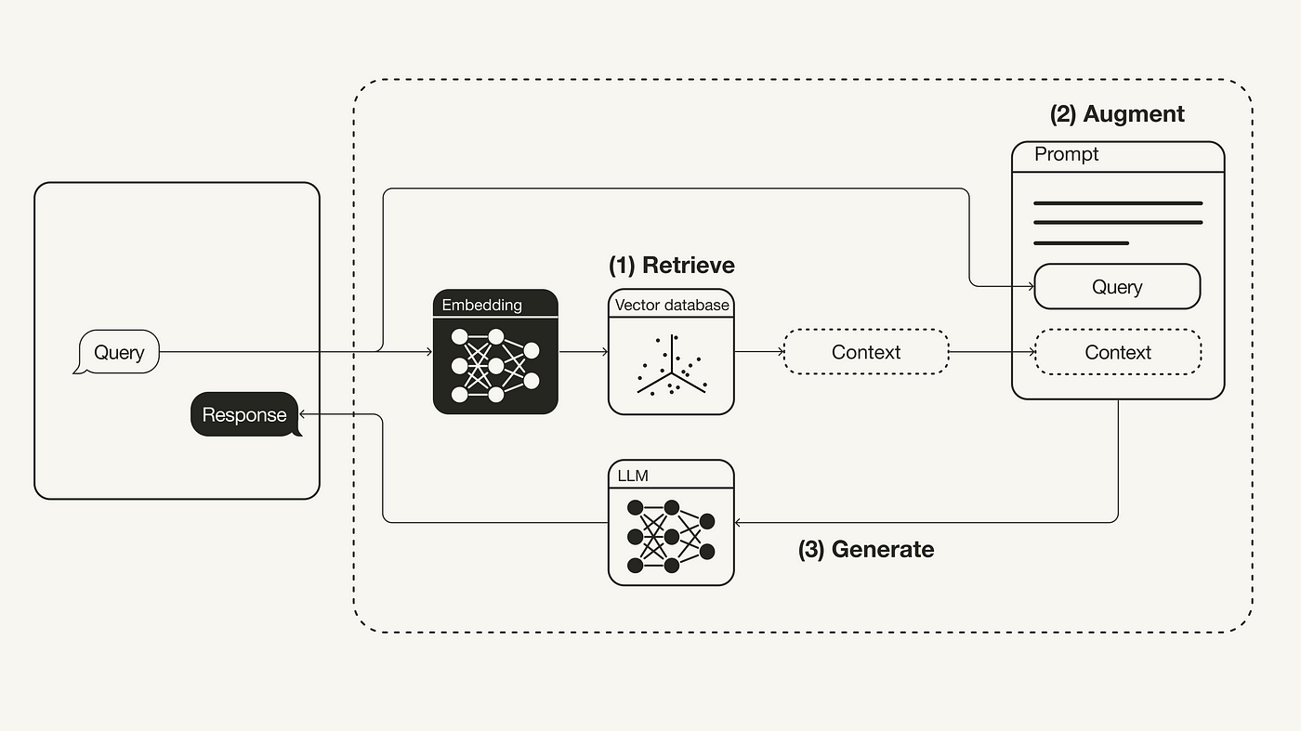
RETRIEVAL-AUGMENTED MODELS
  combine transformer architectures with an external data retrieval system

Slide 7
CONCLUSION
  Fine-tuning: we modify the model; we don’t know the origin of the answear
  In-context learning: no model modification
  Retrieval-augmented model: the origin of a response can be directly traced back to the retrieved documents
FUTURE WORK
  RAG models: document organization and text segmentation methods

Slide 8
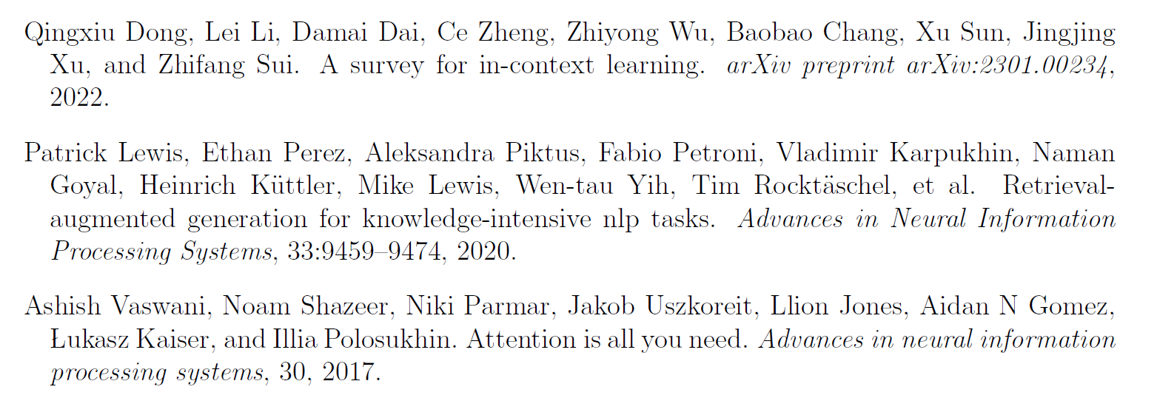
REFERENCES

Slide 9

THANK YOU FOR YOUR
ATTENTION!

