Slide 1
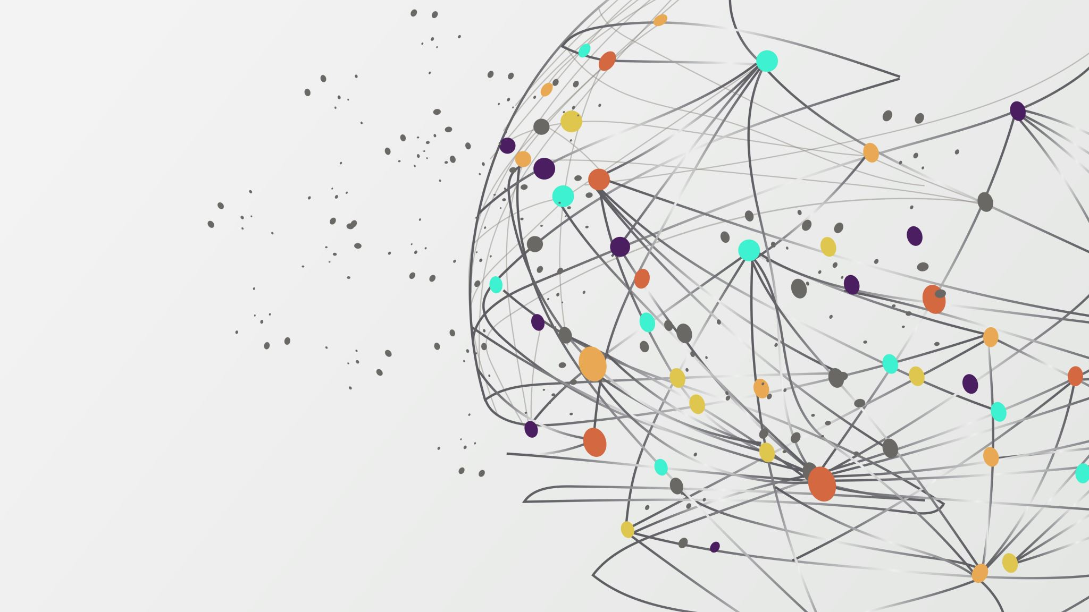
Self-supervised Deep Learning Models on Time-series Data
Created by Vilmos Szirmai
Supervised by Adrián Csiszárik

Slide 2
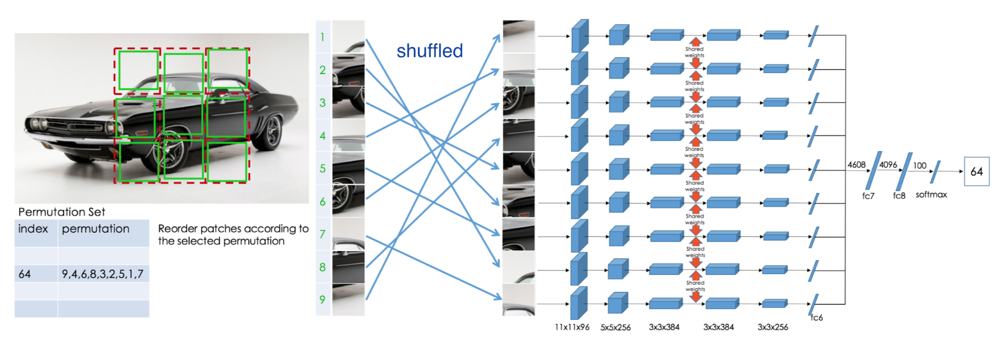
Introduction
Self-supervision in general
Objective: creating labels from data
Relation to Bosch project

Slide 3
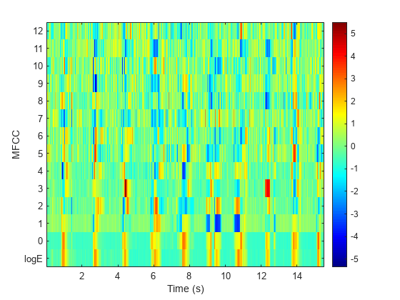
Data preprocessing
Hindi speech classification dataset
MFCC and audio processing workflow

Slide 4
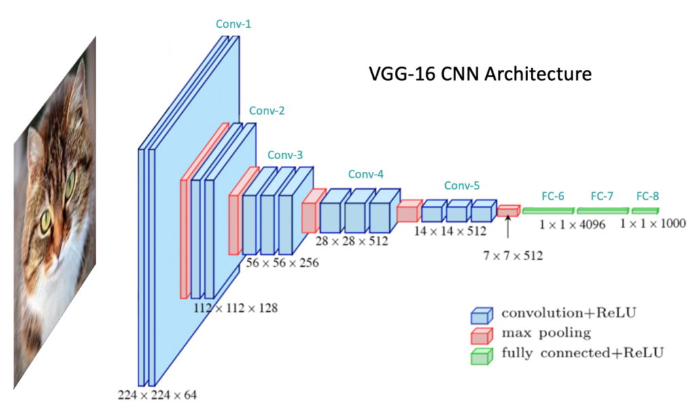
Supervised section
Model: one-dimensional convolutional network
MFCC is an excellent representation
Outstanding accuracy: 0.98

Slide 5
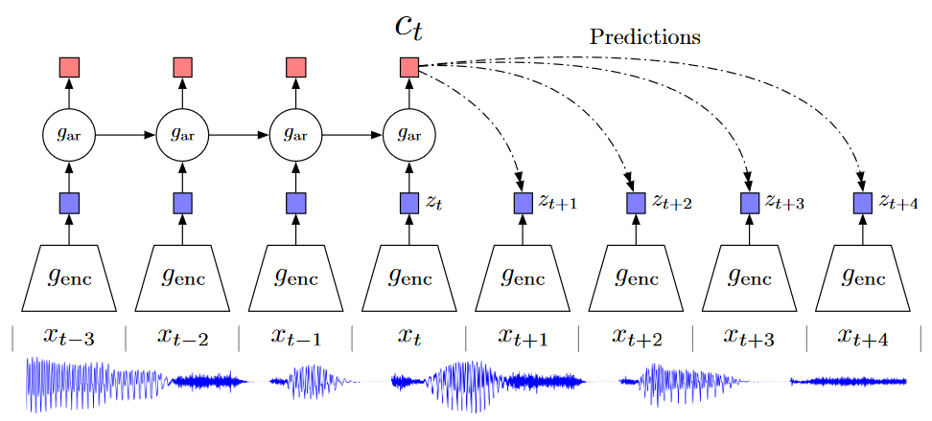
Self-supervision and experiments
Contrastive predictive coding (CPC)
Contrastive loss method among embeddings
Loss computation, inner products
Classification accuracy: approx. 0.75

Slide 6
Conclusion and future work
Future development directions and goals
Planned work with Bosch data

Slide 7
Thank you for your attention!

