Slide 1
Ludo
Modelling project work 2
Lala Ahmadova
Supervisors: Tamaga István, Pataki Peter
Company: Company: ARH ZRT

Slide 2
Content
Goal of this semester
Tools/ Functions
Results
Future plans

Slide 3
Goal
Goal
The plan of this semester is to improve last term’s algorithm to find center points of playfield.
Additionally, detection of dice by two different methods. They are:
Simple image processing tools
Haar Cascade

Slide 4
Tools/ Functions
OpenCv/Python
Hough Circle Transformation
Shape function
Resize

Slide 5
Hough Circle Transformation (CHT)
The function HoughCircles is used in OpenCV to detect the circles in an image. A circle with center (a,b) and radius r, in a binary image, is specified by the parameters (a,b,r) in the equation:
${\left(x−a\right)}^{2}+{\left(y−b\right)}^{2}$ = $r^{2}$
with (x,y) the set edge pixels that make up the circumference of this circle. The parametric representation of the circle is:
$$x=a+r cosθ$$
$$y=b+r sinθ$$

Slide 6
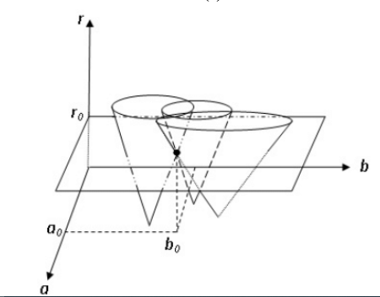
For each edge pixel, the basic Hough transform method constructs a circular cone, in the (a,b,r) parameter space (or Hough space), resulting from the voting process of the (a,b,r) parameters whose associated circles pass through the considered pixel by using a fourfold loop over x, y, a and b.

Slide 7
CHT with fixed radius
This operation runs slowly because it is mainly due to the both use a large number of mathematical operations and trigonometric calculations. To solve this issue the radius can be set to a constant value. Maximum and minimum range of radius can also be provided.
In this case the search can be reduced to 2D. The objective is to find the (a, b) coordinates of the center

Slide 8
The locus of (a, b) points in the parameter space fall on a circle of radius R centered at (x, y). The true center point will be common to all parameter circles, and can be found with a Hough accumulation array.
Each point in geometric space (left) generates a circle in parameter space (right). The circles in parameter space intersect at the (a, b) that is the center in geometric space.

Slide 9
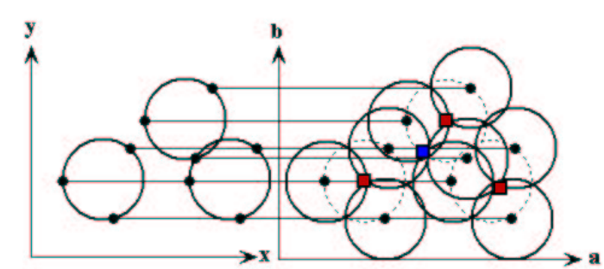
Multiple circles with fixed r
Multiple circles with the same radius can be found with the same technique. The center points are represented as red cells in the parameter space drawing. Overlap of circles can cause spurious centers to also be found, such as at the blue cell. Spurious circles can be removed by matching to circles in the original image.

Slide 10
Image Shape and Resize
The shape of the image is triplet of 3 values: rows, columns and channels and can be get img.shape. In case an image is grayscale then only the number of rows and the number of columns will be get.
resize() is a function to resize an image. The size of the image can be specified manually, or you can specify the scaling factor.

Slide 11
Results

Slide 12
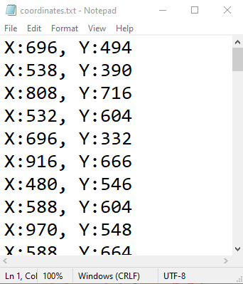

Slide 13
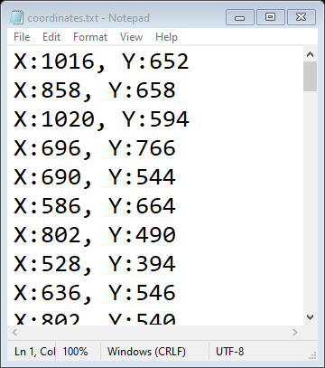

Slide 14
Out of 53 images 10 of them worked well with exact dice detection and value
It found dice but can not read the value correctly for 11 of them
No dice detections for the rest

Slide 15
Future plans
Apply Haar Cascade to find dice
Compare results
To find out the steps on the board

Slide 16
Thank you for your attention!

